Slide 1

Learning PyTorch from Basics to Advanced 2024
Vivian Aranha

Slide 2
What will we cover here?
Beginner Level:
Introduction to PyTorch
What is PyTorch?
Key features and advantages
PyTorch vs other frameworks
History and development
Getting Started with PyTorch
Installation via pip or conda
Setting up a development environment
Running your first PyTorch program
Working with Tensors
Understanding tensors: rank, shape, datatype
Creating tensors from data
Tensor operations: arithmetic, indexing, slicing
Broadcasting and in-place operations
Autograd and Dynamic Computation Graphs
Introduction to autograd
Automatic differentiation with torch.autograd
Dynamic computation graphs in PyTorch
Building Simple Neural Networks
Anatomy of a neural network
Creating neural networks with torch.nn.Module
Training a neural network: forward pass, backward pass
Loss functions and optimizers in PyTorch
Loading and Preprocessing Data
Loading data with torchvision.datasets and torch.utils.data.Dataset
Preprocessing techniques: normalization, resizing, transformations
Custom datasets and data loaders
Batch processing and iterating over datasets
Model Evaluation and Validation
Understanding evaluation metrics: accuracy, precision, recall
Validation techniques: train-validation split, k-fold cross-validation
Monitoring model performance during training
Handling overfitting and underfitting

Slide 3
What will we cover here?
Intermediate Level:
Advanced Neural Network Architectures
Convolutional Neural Networks (CNNs)
Convolutional layers and filters
Pooling layers: max pooling, average pooling
Common CNN architectures: LeNet, AlexNet, VGG, ResNet
Recurrent Neural Networks (RNNs) and LSTMs
Understanding sequential data
LSTM architecture and operations
Applications in natural language processing and time series analysis
Transformer Networks
Self-attention mechanism
Transformer architecture
Applications in natural language processing
Transfer Learning and Fine-Tuning
Introduction to transfer learning
Using pre-trained models from torchvision and Hugging Face Transformers
Fine-tuning models for domain-specific tasks
Feature extraction vs fine-tuning strategies
Handling Complex Data
Image data augmentation techniques
Random cropping, flipping, rotation
Color jittering, brightness/contrast adjustments
Text data preprocessing and tokenization
Tokenization methods: word-level, character-level
Handling sequences of variable length
Time series data handling
Temporal convolutions and recurrent architectures
Feature engineering for time series forecasting
Model Deployment and Production
Saving and loading models with torch.save() and torch.load()
Model serialization and deployment with TorchScript and ONNX
Serving PyTorch models with Flask, FastAPI, and AWS Lambda
Model monitoring and versioning in production
Debugging and Troubleshooting
Understanding common PyTorch errors and warnings
Debugging techniques: printing tensors, using PyTorch debugger (pdb)
Handling numerical stability issues: NaNs, infinities
Profiling and optimizing PyTorch code

Slide 4
What will we cover here?
Advanced Level:
Distributed Training and Performance Optimization
Distributed training with torch.nn.parallel.DistributedDataParallel
Gradient accumulation and gradient clipping
Mixed precision training with NVIDIA Apex
Performance optimization techniques: parallelism, asynchronous processing
Custom Layers and Loss Functions
Creating custom neural network layers with torch.nn.Module
Implementing custom loss functions and metrics
Advanced activation functions: Swish, Mish, GELU
Regularization techniques: dropout, weight decay
Research-oriented Techniques
Reproducibility in machine learning experiments
Experiment tracking with tools like Neptune, Weights & Biases
Hyperparameter tuning strategies: grid search, random search, Bayesian optimization
Staying updated with research papers and conferences
Integration with Other Libraries
Interoperability between PyTorch and TensorFlow/Keras models
Using PyTorch with OpenCV for computer vision tasks
Integration with natural language processing libraries: spaCy, NLTK
Contributing to PyTorch and Community Engagement
Understanding PyTorch's contribution guidelines and codebase
Contributing bug fixes, documentation, and new features
Engaging with the PyTorch community: forums, mailing lists, social media

Slide 5
Introduction to PyTorch
PyTorch has rapidly become one of the most popular deep learning frameworks in the world.
Developed by Facebook's AI Research lab, it provides an intuitive and flexible platform for researchers and developers to build, train, and deploy neural networks with ease.
Whether you're an academic looking to push the boundaries of machine learning research or a developer aiming to integrate state-of-the-art AI into production systems, PyTorch offers the tools and community support needed to achieve your goals.
In this section, we will dive into the core concepts of PyTorch, exploring what makes it unique, how it compares to other frameworks, and its evolution over time.
By the end of this section, you'll have a solid understanding of PyTorch's foundations, setting the stage for deeper explorations into its more advanced capabilities.

Slide 6
What is PyTorch?
PyTorch is an open-source deep learning framework that enables you to build and train neural networks with flexibility and ease.
It is designed to accelerate the process of prototyping, building, and deploying machine learning models, especially in the fields of computer vision and natural language processing (NLP).
Unlike traditional machine learning libraries that rely on static computational graphs, PyTorch uses dynamic computational graphs, allowing developers to modify the graph on the fly.
This makes it particularly suited for research purposes where experimentation and rapid iteration are key.

Slide 7
What is PyTorch?
Key Points:
Dynamic Computational Graphs: PyTorch allows for flexible model building, where graphs are built as the operations are defined, enabling real-time debugging and experimentation.
Pythonic Nature: PyTorch integrates seamlessly with Python, allowing developers to leverage the extensive Python ecosystem and write code that feels natural and intuitive.
Tensors: At its core, PyTorch operates on tensors, which are multidimensional arrays similar to NumPy arrays but with additional capabilities for GPU acceleration.
Autograd: PyTorch’s automatic differentiation engine, Autograd, enables efficient computation of gradients, which is essential for training deep learning models using backpropagation.

Slide 8
Key Features and Advantages
PyTorch stands out in the crowded field of deep learning frameworks due to several key features and advantages that make it the preferred choice for many researchers and practitioners.
Dynamic vs Static Graphs
Dynamic Graphs: Unlike TensorFlow's static computational graph approach (prior to TensorFlow 2.0), PyTorch’s dynamic graphs are more flexible and easier to debug. This is particularly beneficial during the research phase, where models are often changed frequently.
Ease of Use: PyTorch's design philosophy emphasizes simplicity and ease of use, making it accessible to beginners while still powerful enough for advanced users.
Seamless Integration with Python
Pythonic Syntax: PyTorch's syntax is intuitive and closely mirrors standard Python code, reducing the learning curve and allowing for easy integration with Python libraries like NumPy and SciPy.
Community Support: PyTorch has a large and active community, which contributes to a wealth of tutorials, documentation, and third-party libraries that can accelerate development.

Slide 9
Key Features and Advantages
GPU Acceleration
Efficient Computation: PyTorch supports seamless execution on GPUs, significantly speeding up the training process of large models. With just a few lines of code, you can move your models and data to GPU, harnessing the power of modern hardware.
Robust Ecosystem
Libraries and Extensions: PyTorch offers a range of libraries and tools, such as TorchVision for computer vision, TorchText for NLP, and TorchServe for model deployment, that make it a comprehensive framework for various applications.
Research and Production: PyTorch strikes a balance between being a research-friendly platform and a robust production-ready framework. This dual nature makes it versatile and widely adopted across academia and industry.

Slide 10
PyTorch vs Other Frameworks
PyTorch is often compared to other deep learning frameworks, each with its strengths and trade-offs. In this subsection, we'll compare PyTorch with TensorFlow, Keras, and other popular frameworks.
PyTorch vs TensorFlow
Graph Construction: PyTorch uses dynamic graphs, allowing on-the-fly changes, while TensorFlow traditionally used static graphs, which can be less intuitive but offer optimization benefits (although TensorFlow 2.0 introduced eager execution to bridge this gap).
Learning Curve: PyTorch is often praised for its ease of use and intuitive syntax, making it more beginner-friendly compared to the more complex TensorFlow.
Community and Ecosystem: TensorFlow has a larger ecosystem and more tools for production deployment, but PyTorch’s growing community and native integration with Python make it a strong contender.

Slide 11
PyTorch vs Other Frameworks
PyTorch vs Keras
Flexibility: Keras, being a high-level API, is simpler and more abstract, which can be an advantage for quick prototyping but may limit flexibility. PyTorch, with its low-level approach, offers more control over the model-building process.
Performance: PyTorch generally provides better performance, especially for research purposes, due to its fine-grained control over computations.
PyTorch vs Other Frameworks
MXNet: MXNet offers a blend of dynamic and static graphs but is less popular and lacks the extensive community support that PyTorch enjoys.
Chainer: Chainer, like PyTorch, uses dynamic graphs but has a smaller community and ecosystem.

Slide 12
History and Development
Understanding the history of PyTorch provides insight into its design choices and why it has become so popular in the AI community.
Origins
Developed by Facebook AI Research (FAIR): PyTorch was created by FAIR in 2016 as an evolution of the Torch library, which was primarily used in the Lua programming language. The shift to Python was motivated by the need for a more widely adopted and flexible language.
Key Milestones
PyTorch 1.0 (2018): Marked the merging of PyTorch and Caffe2, bringing together the flexibility of PyTorch with the production capabilities of Caffe2, making PyTorch more suitable for both research and deployment.
Growing Adoption: Over the years, PyTorch has seen exponential growth in adoption, especially in academic research, due to its ease of use and dynamic nature.
Recent Developments: The introduction of PyTorch XLA for TPU support and the PyTorch Lightning library for simplifying model training has further solidified PyTorch's position as a leading framework.

Slide 13
History and Development
Community and Ecosystem
Community Contributions: PyTorch has a vibrant community that actively contributes to its development, leading to continuous improvements and the rapid addition of new features.
Industry Adoption: PyTorch's adoption in industry has grown, with companies like Facebook, Microsoft, and Tesla using it in production environments.

Slide 14
Getting Started with PyTorch
Introduction
Before diving into deep learning models and complex neural networks, it’s crucial to ensure you have PyTorch installed and ready to use in your development environment.
In this section, we will guide you through the installation process of PyTorch using pip and conda, how to set up a robust development environment, and run your first PyTorch program.
By the end of this section, you will have a functioning setup that allows you to start experimenting with the core features of PyTorch.

Slide 15
Installation via pip or conda
Installing PyTorch is a straightforward process, and depending on your preference, you can either use pip (Python’s package installer) or conda (the package and environment manager from Anaconda).
Installation using pip:
If you are using pip as your package manager, PyTorch can be installed by simply executing the following command in your terminal or command prompt:
This command installs three components:
torch: The core PyTorch library.
torchvision: A library that provides popular datasets, model architectures, and image transformations for computer vision tasks.
torchaudio: A library for audio processing tasks.

Slide 16
Installation via pip or conda
Installation using conda:
If you prefer using conda (especially useful if you are working within the Anaconda ecosystem), you can install PyTorch by specifying the correct version for your system:
This command uses the official PyTorch channel on conda to ensure you get the correct versions of PyTorch and related libraries.
Installing with CUDA (for GPU acceleration):
PyTorch can leverage GPU acceleration through NVIDIA's CUDA platform. If you have an NVIDIA GPU and the necessary drivers installed, you can install PyTorch with GPU support.
For pip:
For conda:
Make sure to replace the CUDA version (11.8) with the version compatible with your system.

Slide 17
Setting up a Development Environment
To effectively work with PyTorch, it is essential to set up a development environment that supports efficient coding, debugging, and testing of your models. In this subsection, we will guide you through the process of setting up such an environment.
Choosing a Code Editor/IDE:
Several development environments are commonly used with PyTorch, and each has its pros and cons. Some popular options include:
VS Code (Visual Studio Code): A lightweight but powerful code editor with great support for Python and Jupyter notebooks. It also has useful extensions for PyTorch development, such as the PyTorch snippets extension.
Jupyter Notebooks: Ideal for interactive development, allowing you to run code cells independently and visualize outputs, which is perfect for testing small snippets of PyTorch code.
PyCharm: A robust IDE for Python development with excellent code navigation, debugging tools, and virtual environment support.

Slide 18
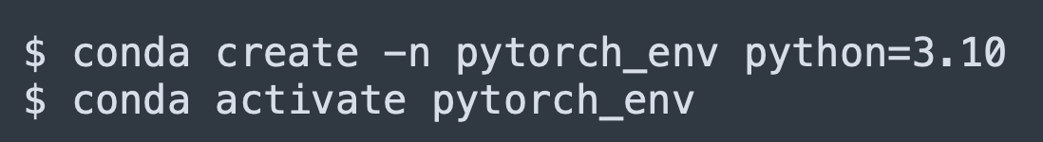
Setting up a Development Environment
Setting Up Virtual Environments:
It’s a good practice to create isolated virtual environments for your PyTorch projects to avoid conflicts with other Python packages. Depending on your package manager, you can set up a virtual environment as follows:
Using venv (Python's built-in virtual environment tool):
Using conda:
After activating the virtual environment, you can install PyTorch as described earlier

Slide 19



Setting up a Development Environment
Installing Essential Development Tools:
To enhance your development workflow, it’s helpful to install additional tools such as:
Jupyter Notebook: For interactive coding:
Matplotlib: For plotting and visualizing data:
IPython: For a more powerful interactive Python shell:
These tools help you write, test, and visualize your PyTorch code effectively.

Slide 20
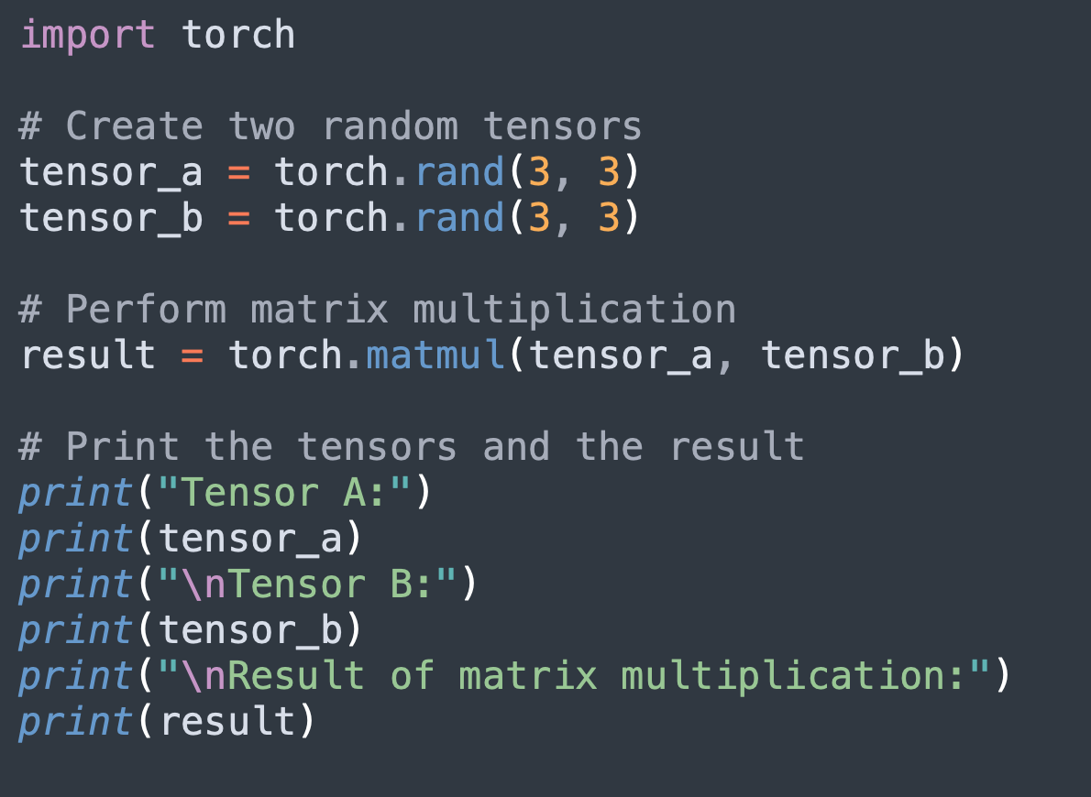
Running Your First PyTorch Program
Now that you have PyTorch installed and your environment set up, it’s time to write and run your first PyTorch program. In this subsection, we will walk through a simple program that demonstrates some core PyTorch concepts, including tensor creation and basic operations.
Creating a Simple PyTorch Program:
Open your preferred code editor or Jupyter notebook and create a new Python file (e.g., first_pytorch_program.py).
Here’s a simple PyTorch program that demonstrates how to create a tensor, perform a matrix multiplication, and display the result:

Slide 21
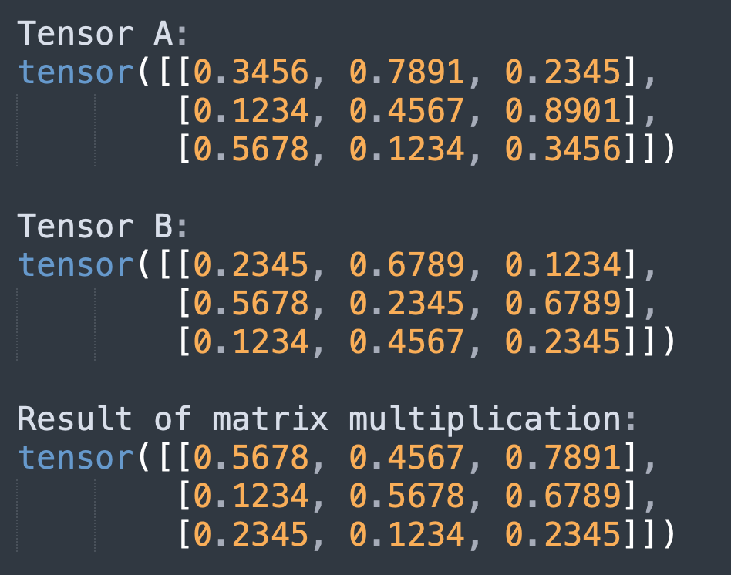
Running Your First PyTorch Program
Running the Program
To run the program, simply execute the Python file in your terminal or use the run functionality of your IDE. If you’re using a Jupyter notebook, execute the code cell.
If everything is set up correctly, you should see the output similar to the following:

Slide 22
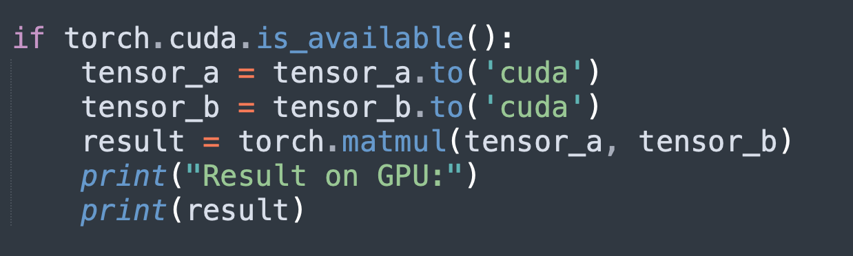
Running Your First PyTorch Program
Exploring Further
To take it a step further, try creating different types of tensors (such as zeros, ones, or random tensors), performing element-wise operations, and moving tensors to the GPU if available. Here’s an example of moving a tensor to a GPU:
This will utilize the GPU for computations, which can significantly speed up training for larger models.

Slide 23
Working with Tensors
Introduction
Tensors are the fundamental building blocks in PyTorch, much like arrays in NumPy but with additional capabilities tailored for deep learning.
Understanding how to work with tensors is crucial as they are used to represent inputs, outputs, weights, and everything in between in a neural network.
In this section, we will dive deep into the concept of tensors, exploring their structure, how to create them, and the various operations you can perform on them.
By the end of this section, you will have a strong grasp of how to manipulate tensors, which is essential for building and optimizing deep learning models.

Slide 24
Understanding Tensors: Rank, Shape, Datatype
Before diving into tensor creation and operations, it’s important to understand the basic attributes of tensors—rank, shape, and datatype.
Rank (or Dimensionality)
Definition: The rank of a tensor refers to the number of dimensions it has. For example, a scalar is a tensor with rank 0, a vector is rank 1, a matrix is rank 2, and so on.
Rank 0: Scalar (e.g., 3)
Rank 1: Vector (e.g., [1, 2, 3])
Rank 2: Matrix (e.g., [[1, 2, 3], [4, 5, 6]])
Higher Ranks: Tensors can have higher ranks (3D, 4D, etc.) depending on the application (e.g., 3D tensors for RGB images, 4D tensors for batches of images).
Shape
Definition: The shape of a tensor is a tuple that gives the size of each dimension. For example, a 2D tensor with shape (3, 4) represents a matrix with 3 rows and 4 columns.
Example: A tensor with shape (2, 3, 4) would have 2 matrices of shape (3, 4) stacked together.

Slide 25
Understanding Tensors: Rank, Shape, Datatype
Datatype
Definition: Tensors can store data of different types, such as integers, floats, or booleans. The datatype is important for precision and memory usage.
Common Datatypes: torch.float32, torch.int64, torch.bool.
Example: A tensor with dtype=torch.float32 would store 32-bit floating-point numbers.
Understanding these attributes is crucial because they determine how tensors are stored in memory and how operations are applied to them.

Slide 26
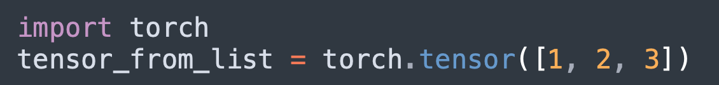
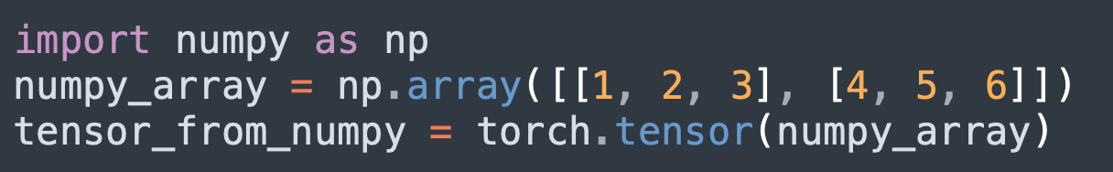
Creating Tensors from Data
Tensors can be created in various ways depending on the data you have and the requirements of your model. In this subsection, we will cover the most common methods to create tensors.
Creating Tensors from Lists or Arrays
From Lists: You can easily convert Python lists or nested lists into PyTorch tensors using the torch.tensor() function.
Example:
From NumPy Arrays: Tensors can also be created from NumPy arrays, which is useful if you are transitioning from a NumPy-based codebase.
Example:

Slide 27
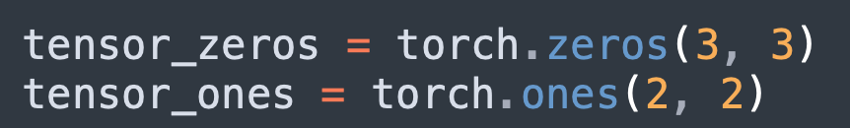
Creating Tensors from Data
Creating Tensors with Specific Values
Zeros and Ones: PyTorch provides functions to create tensors filled with zeros or ones, which are often used for initialization purposes.
Example:
Random Tensors: Random tensors are commonly used for initializing weights in neural networks.
Example:

Slide 28
Creating Tensors from Data
Specifying Datatypes and Devices
Datatype: When creating a tensor, you can specify its datatype using the dtype argument.
Example:
Device (CPU/GPU): Tensors can be created directly on a GPU if available, which is crucial for performance in deep learning tasks.
Example:

Slide 29
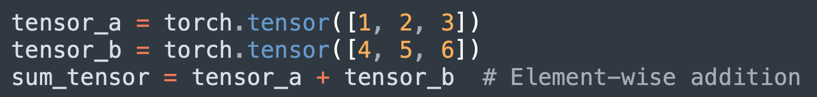
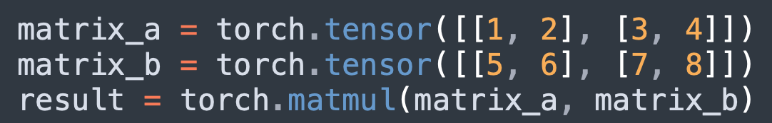
Tensor Operations: Arithmetic, Indexing, Slicing
Once tensors are created, various operations can be performed on them. This subsection covers the basics of arithmetic operations, indexing, and slicing, which are essential for manipulating and extracting data from tensors.
Arithmetic Operations
Element-wise Operations: PyTorch supports element-wise arithmetic operations such as addition, subtraction, multiplication, and division.
Example:
Matrix Multiplication: Matrix multiplication is a key operation in neural networks and can be performed using torch.matmul() or the @ operator.
Example:

Slide 30
Tensor Operations: Arithmetic, Indexing, Slicing
Indexing
Single Element Access: Similar to Python lists or NumPy arrays, you can access individual elements of a tensor using square brackets.
Example:
Slicing
Sub-tensors: You can extract sub-tensors by specifying ranges of indices, similar to slicing in Python.
Example:
Advanced Indexing: PyTorch also supports advanced indexing, such as selecting specific rows or columns using lists of indices.
Example:

Slide 31
Broadcasting and In-Place Operations
In this subsection, we’ll explore more advanced tensor operations, including broadcasting, which allows for efficient computation with tensors of different shapes, and in-place operations, which modify tensors without creating new ones.
Broadcasting
Concept: Broadcasting is a technique used by PyTorch to perform operations on tensors of different shapes. The smaller tensor is "broadcast" across the larger tensor so that they have compatible shapes for element-wise operations.
Example:
Rules: Broadcasting follows specific rules regarding dimension matching. Understanding these rules is crucial for avoiding shape mismatches and ensuring efficient computation.

Slide 32
Broadcasting and In-Place Operations
In-Place Operations
Definition: In-place operations modify the content of a tensor without allocating new memory, which can be more efficient but should be used cautiously to avoid unintended side effects.
Notation: In PyTorch, in-place operations are typically denoted by a trailing underscore (e.g., add_()).
Example:
Use Cases: In-place operations are useful in scenarios where memory efficiency is critical, but they can lead to bugs if the original tensor is needed elsewhere in its original state.

Slide 33
Autograd and Dynamic Computation Graphs
Introduction
One of the core features that makes PyTorch a powerful framework for deep learning is its ability to automatically compute gradients.
This is facilitated by PyTorch’s autograd module, which enables automatic differentiation—essential for optimizing neural networks.
Additionally, PyTorch's dynamic computation graphs allow for a more flexible and intuitive way to build and modify models on the fly.
In this section, we will explore these features in detail, providing you with a deep understanding of how PyTorch handles gradient computation and why dynamic computation graphs are a game-changer for deep learning research and development.

Slide 34
Introduction to Autograd
The autograd module is at the heart of PyTorch’s capability to automatically compute gradients for tensor operations. Gradients are essential in the optimization of neural networks as they provide the necessary information to update model parameters during training.
What is Autograd?
Definition: Autograd is PyTorch’s automatic differentiation engine that records operations performed on tensors to create a computation graph. This graph is used to calculate gradients during backpropagation.
Importance: Gradients are used to optimize the loss function, guiding the model in the right direction during training.
How Autograd Works
Computation Graph: When you perform operations on tensors, PyTorch dynamically constructs a computation graph that tracks the dependencies between tensors.
Backward Pass: During the backward pass, autograd traverses this graph to compute gradients for each tensor involved in the operations.

Slide 35
Introduction to Autograd
Key Concepts
Requires Grad: By default, PyTorch does not compute gradients for tensors. To enable gradient computation, you must set requires_grad=True when creating a tensor.
Example:
Gradients: Once gradients are computed, they are stored in the .grad attribute of the tensor.

Slide 36
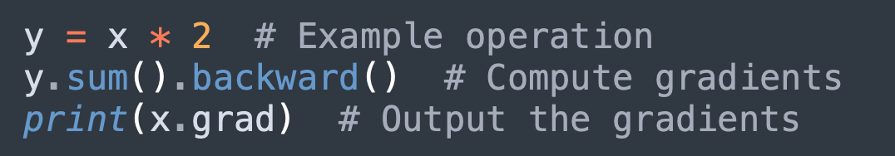
Automatic Differentiation with torch.autograd
In this video, we will delve deeper into how to use the torch.autograd module to perform automatic differentiation, which is essential for training deep learning models.
Computing Gradients
Backward Method: After performing some operations on a tensor, you can compute the gradient by calling the backward() method on the result.
Example:
Gradient Accumulation: Gradients are accumulated into the .grad attribute by default, which means that calling backward() multiple times without resetting gradients can lead to incorrect results. You can reset gradients using zero_grad().

Slide 37
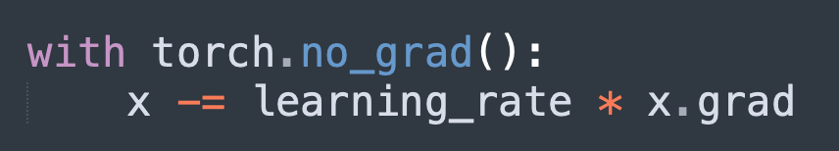
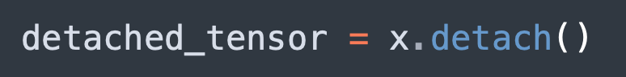
Automatic Differentiation with torch.autograd
Gradient Descent
Optimization: The gradients computed by autograd are used to update model parameters using an optimization algorithm such as gradient descent.
Example:
Detaching Tensors: Sometimes, you may need to detach a tensor from the computation graph to stop it from tracking gradients. This can be done using the detach() method.
Example:

Slide 38
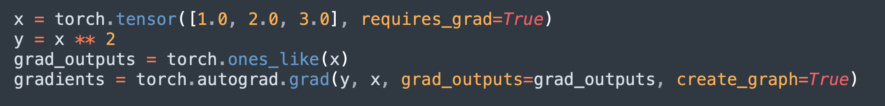
Automatic Differentiation with torch.autograd
Higher-Order Gradients
Support for Higher-Order Gradients: PyTorch also supports higher-order gradients, which are necessary for certain advanced techniques like meta-learning.
Example:

Slide 39
Dynamic Computation Graphs in PyTorch
One of the key differences between PyTorch and other deep learning frameworks like TensorFlow (pre-2.0) is the use of dynamic computation graphs. This subsection explores how these graphs work and why they are advantageous.
What are Dynamic Computation Graphs?
Definition: Dynamic computation graphs, also known as define-by-run graphs, are built on the fly as operations are executed. Unlike static graphs, which are defined before running the model, dynamic graphs allow you to modify the graph structure during runtime.
Flexibility: This feature provides greater flexibility, especially in research and experimentation, where model architectures may need to be adjusted frequently.
Advantages of Dynamic Computation Graphs
Ease of Use: The define-by-run approach makes the code more intuitive and closer to standard Python code, reducing the learning curve for new users.
Debugging: Dynamic graphs are easier to debug because they are built step-by-step, allowing for the use of standard Python debugging tools.
Conditionals and Loops: PyTorch’s dynamic graphs support conditionals and loops naturally, making it easier to implement complex model architectures such as RNNs and recursive models.

Slide 40
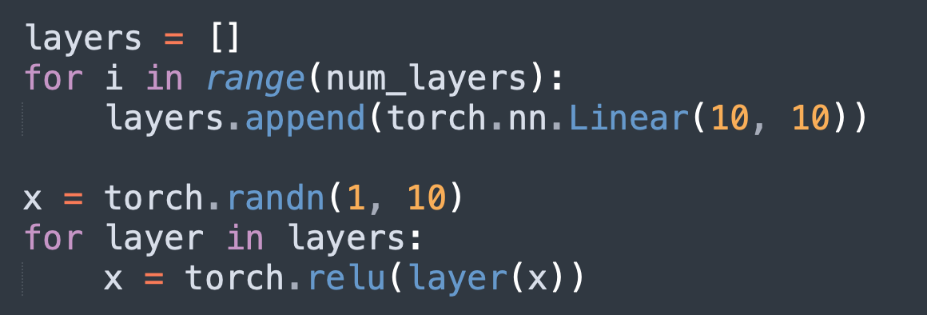
Dynamic Computation Graphs in PyTorch
Practical Example of Dynamic Graphs
Example: Consider a model where the number of layers is determined by an external condition, such as the length of an input sequence. With dynamic computation graphs, you can easily adjust the number of layers based on runtime conditions.
Example
This approach allows you to build and modify models in a more natural and flexible way, accommodating the needs of modern deep learning research and applications.

Slide 41
Building Simple Neural Networks
Introduction
Neural networks are the backbone of modern deep learning.
They consist of layers of interconnected neurons, which are designed to automatically learn patterns from data.
Building and training neural networks is a core skill in deep learning, and PyTorch makes it straightforward with its modular design.
In this section, we will explore the fundamental components of a neural network, how to construct neural networks using PyTorch’s torch.nn.Module, and the essential steps involved in training them.
We will also cover the crucial concepts of loss functions and optimizers, which play a key role in the learning process.

Slide 42
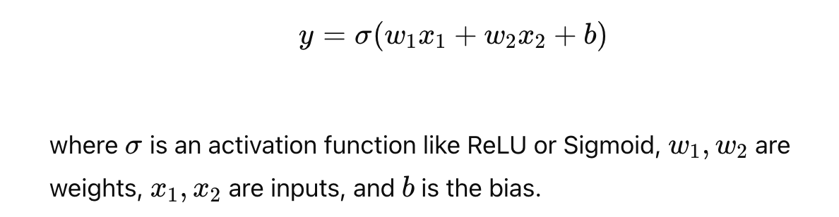
Anatomy of a Neural Network
To build and understand neural networks, it’s important to grasp their basic structure and how the different components interact with each other.
Neurons and Layers
Neurons: The basic building blocks of a neural network are neurons, which are analogous to biological neurons in the brain. Each neuron takes inputs, processes them, and produces an output. In mathematical terms, a neuron performs a weighted sum of its inputs, applies an activation function, and produces an output.
Example: A single neuron might calculate the following:

Slide 43
Anatomy of a Neural Network
Layers: Neurons are grouped into layers. A typical neural network has an input layer, one or more hidden layers, and an output layer.
Input Layer: Receives the input data.
Hidden Layers: Perform computations and extract features. These layers can vary in number and size depending on the complexity of the task.
Output Layer: Produces the final output of the network, such as class scores in a classification task.

Slide 44
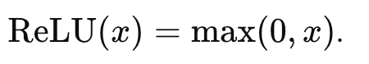
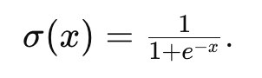
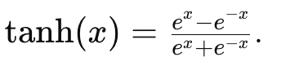
Anatomy of a Neural Network
Forward Pass
Definition: The forward pass is the process where input data is passed through the network layer by layer, producing an output. This output is then compared with the ground truth to calculate the loss.
Activation Functions
Role: Activation functions introduce non-linearity into the model, allowing the network to learn complex patterns. Common activation functions include:
ReLU (Rectified Linear Unit): The most popular activation function, defined as
Sigmoid: Used in binary classification problems, defined as
Tanh: Another activation function that outputs values between -1 and 1, defined as

Slide 45
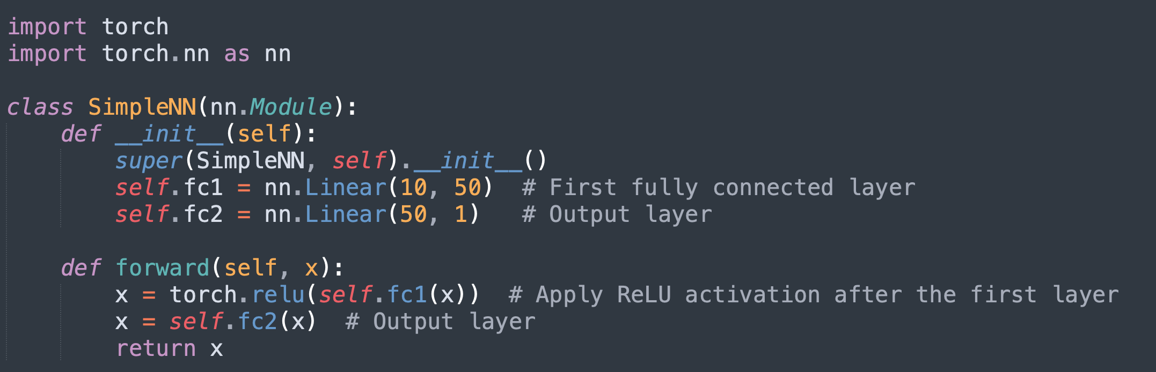
Creating Neural Networks with torch.nn.Module
PyTorch provides the torch.nn.Module class, which is a base class for all neural network modules. It’s designed to encapsulate the structure and behavior of neural networks.
Defining a Neural Network Class
Subclassing torch.nn.Module: To define a neural network in PyTorch, you create a class that inherits from torch.nn.Module. This class must implement two methods: __init__() to define the network's layers and forward() to define how the input data flows through the network.
Example:

Slide 46
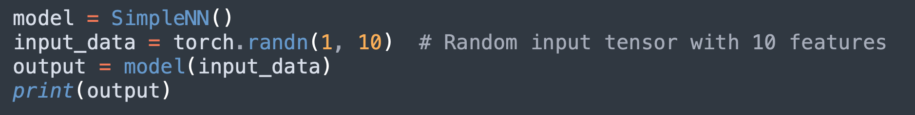
Creating Neural Networks with torch.nn.Module
Initializing and Using the Network
Instantiation: Once the network class is defined, you can instantiate it and pass data through it.
Example:
Parameters: The parameters of the model, such as weights and biases, are automatically registered and can be accessed using model.parameters().
Managing Complexity
Modular Design: PyTorch encourages modular design, where complex networks are composed of smaller, reusable modules. For example, you can create custom layers by combining existing layers or by defining new layers that inherit from torch.nn.Module.

Slide 47
Training a Neural Network: Forward Pass, Backward Pass
Training a neural network involves a cycle of forward and backward passes, followed by updates to the model’s parameters.
Forward Pass
Definition: The forward pass involves passing the input data through the network to obtain predictions. This is the first step in the training process and is used to compute the loss.
Backward Pass (Backpropagation)
Definition: The backward pass involves computing the gradients of the loss with respect to each parameter of the network using backpropagation. This is done by calling the backward() method on the loss.
Example:
Gradient Descent: The gradients are then used to update the model’s parameters in the direction that reduces the loss, typically using an optimizer.
Epochs and Iterations
Epoch: One complete pass through the entire training dataset.
Iteration: One pass through a single batch of data. The number of iterations per epoch depends on the batch size and the size of the dataset.

Slide 48
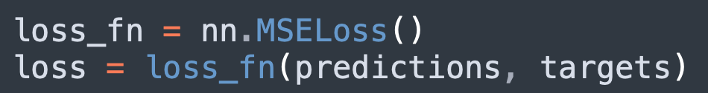
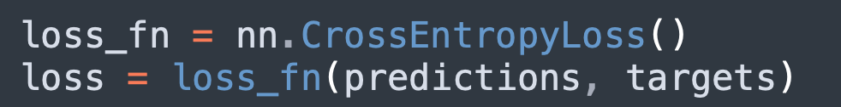
Loss Functions and Optimizers in PyTorch
Loss functions and optimizers are key components in the training process. The loss function quantifies how well the model’s predictions match the target values, while the optimizer updates the model’s parameters to minimize this loss.
Loss Functions
Definition: A loss function measures the difference between the network’s predictions and the actual targets. PyTorch provides several loss functions for different types of tasks:
MSE Loss (Mean Squared Error): Used for regression tasks where the goal is to predict continuous values.
Example:
Cross-Entropy Loss: Commonly used in classification tasks where the target is a category.
Example:

Slide 49
Loss Functions and Optimizers in PyTorch
Optimizers
Definition: An optimizer updates the network's parameters based on the computed gradients. PyTorch provides several optimizers, including:
SGD (Stochastic Gradient Descent): The most basic optimizer that updates parameters by moving them in the direction of the negative gradient.
Example:
Adam: An advanced optimizer that adapts the learning rate for each parameter, often leading to faster convergence.
Example:

Slide 50
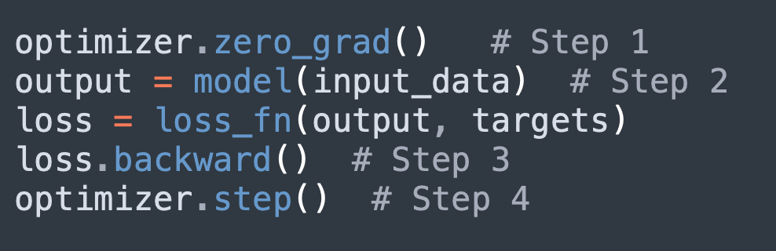
Loss Functions and Optimizers in PyTorch
Optimizers
Optimization Loop:
Step 1: Zero the gradients to prevent gradient accumulation.
Step 2: Perform the forward pass and compute the loss.
Step 3: Perform the backward pass to compute gradients.
Step 4: Update the parameters using the optimizer.
Example:

Slide 51
Loading and Preprocessing Data
Introduction
Data is the fuel that powers neural networks.
However, raw data is often messy and unstructured, requiring careful preprocessing before it can be fed into a model.
PyTorch provides powerful tools for loading and preprocessing data, making it easier to manage large datasets and perform necessary transformations.
In this section, we will explore how to efficiently load data using torchvision.datasets and torch.utils.data.Dataset, apply common preprocessing techniques such as normalization and resizing, create custom datasets, and handle batch processing.
By the end of this section, you will be well-equipped to manage and preprocess data for your deep learning projects.

Slide 52
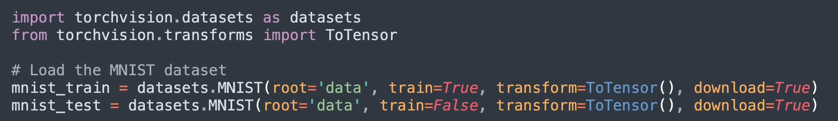
Loading Data with torchvision.datasets and torch.utils.data.Dataset
One of the most important tasks in deep learning is efficiently loading and managing data. PyTorch provides two essential tools for this: torchvision.datasets for standard datasets and torch.utils.data.Dataset for custom datasets.
Loading Standard Datasets with torchvision.datasets
Overview: torchvision.datasets provides access to popular datasets such as MNIST, CIFAR-10, and ImageNet, which are commonly used for training and benchmarking deep learning models.
Example:
Transformations: The transform argument allows you to apply preprocessing steps like converting images to tensors, normalizing pixel values, and more.

Slide 53
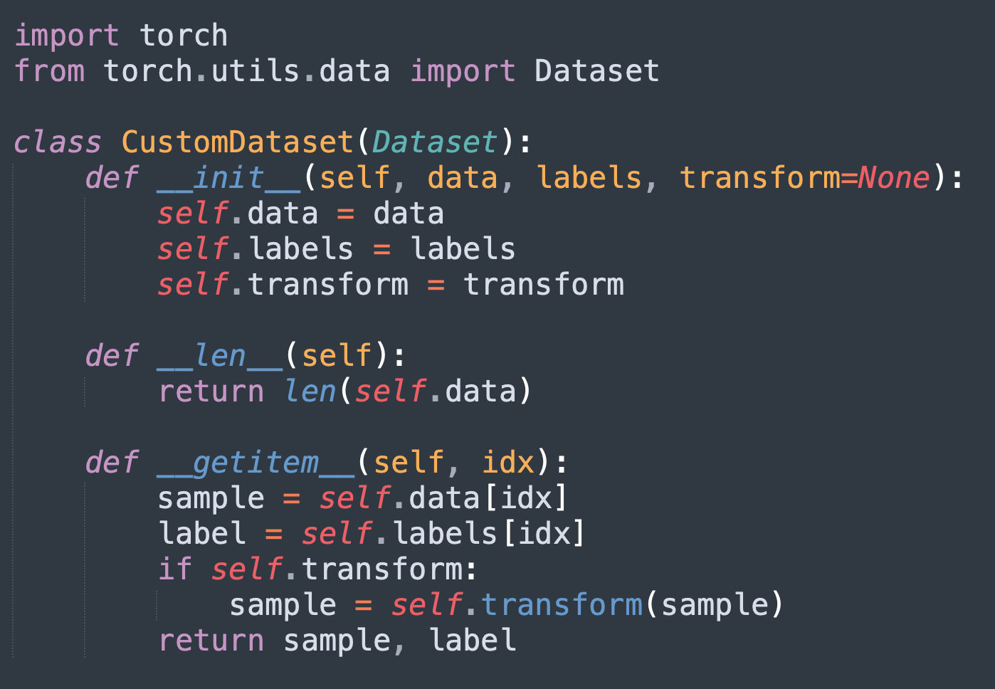
Loading Data with torchvision.datasets and torch.utils.data.Dataset
Custom Datasets with torch.utils.data.Dataset
Overview: When working with datasets that are not available in torchvision.datasets, you can create your own dataset class by subclassing torch.utils.data.Dataset.
Creating a Custom Dataset:
Step 1: Subclass torch.utils.data.Dataset.
Step 2: Implement the __len__() method to return the number of samples in the dataset.
Step 3: Implement the __getitem__() method to load and return a sample from the dataset at the given index.
Example:

Slide 54
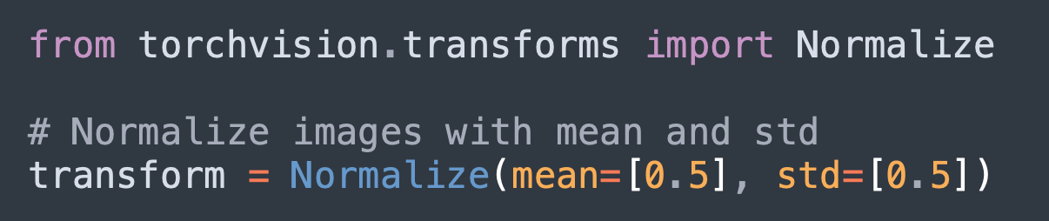
Preprocessing Techniques: Normalization, Resizing, Transformations
Preprocessing is a crucial step that can significantly impact the performance of your model. Common techniques include normalization, resizing, and other transformations that prepare data for training.
Normalization
Definition: Normalization involves scaling the input data to a specific range, typically [0, 1] or [-1, 1]. This helps in speeding up the training process and can lead to better convergence.
Example:

Slide 55
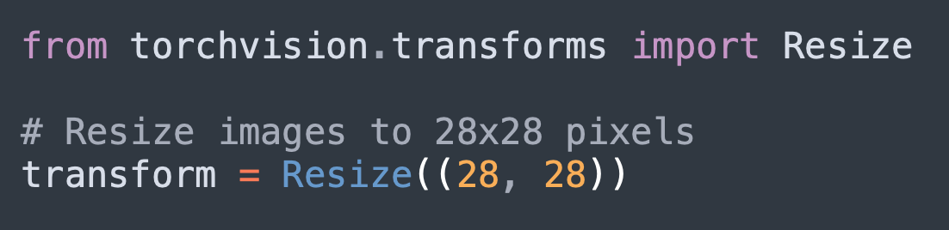
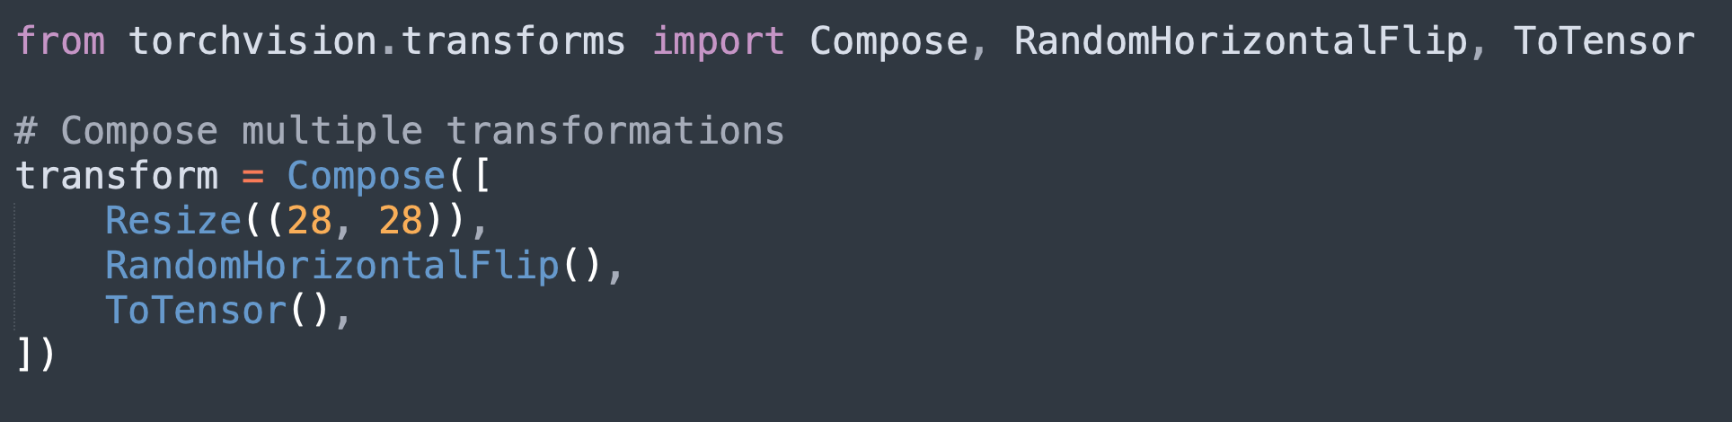
Preprocessing Techniques: Normalization, Resizing, Transformations
Resizing
Definition: Resizing images to a fixed size is necessary when working with neural networks, as they often expect input images to have the same dimensions.
Example:
Transformations
Overview: PyTorch's torchvision.transforms module provides a variety of transformations that can be applied to images, including random cropping, flipping, rotation, and more.
Example:

Slide 56
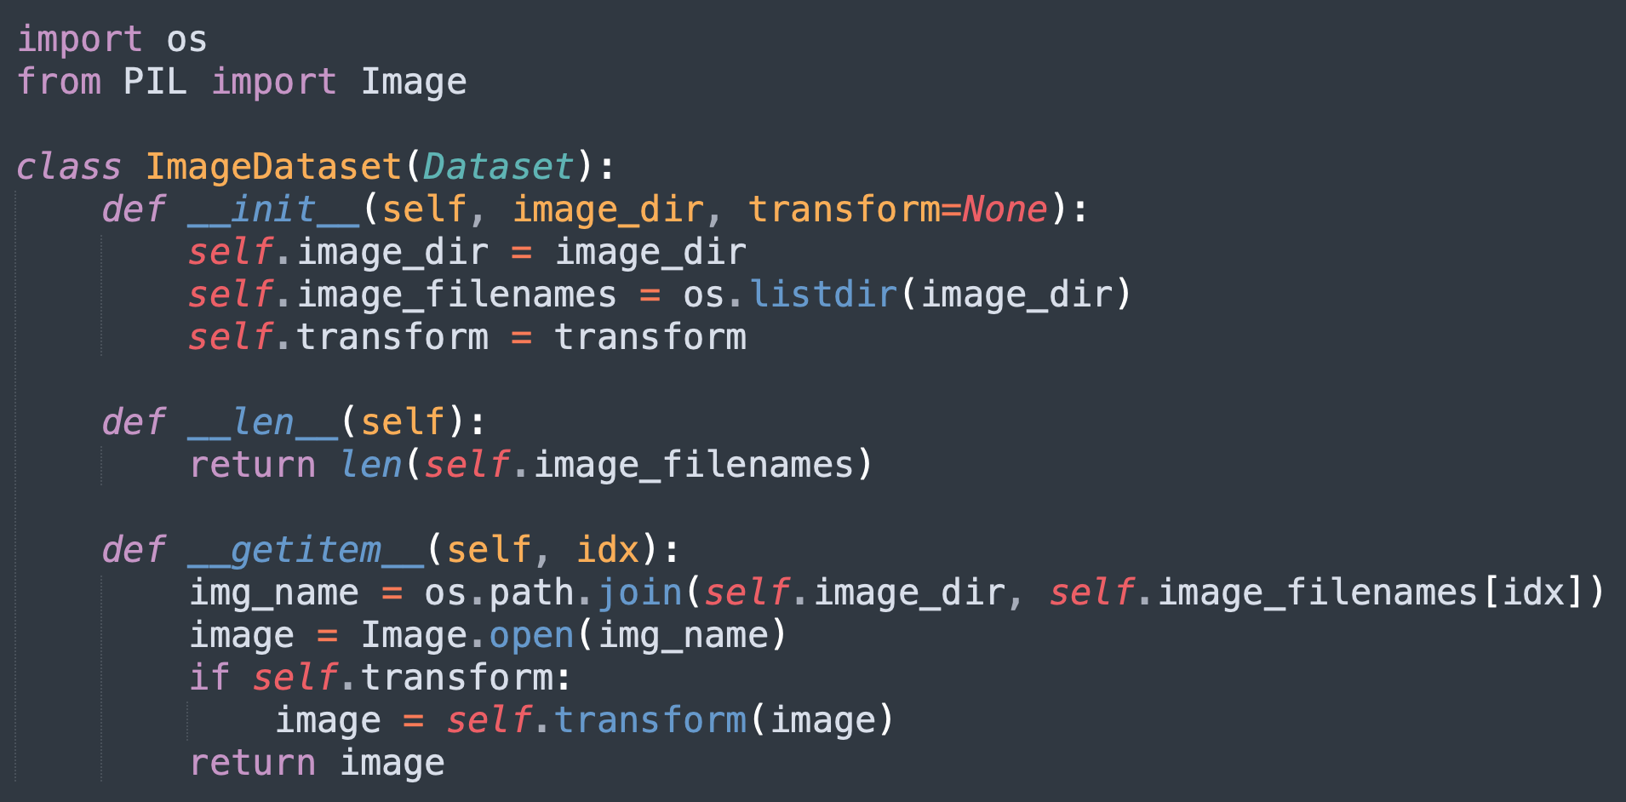
Custom Datasets and Data Loaders
When working with datasets that are not pre-processed or require custom handling, you can create custom datasets and data loaders.
Custom Dataset Implementation
Data Organization: Custom datasets often involve loading data from various sources such as images, text files, or even databases. Organizing and handling these data efficiently is key.
Example:

Slide 57
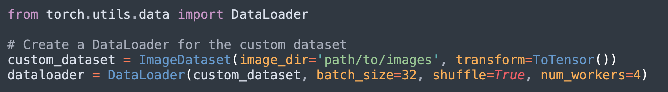
Custom Datasets and Data Loaders
Data Loaders
Definition: Data loaders are used to load data in batches, shuffle the data, and handle parallel data loading using multiple workers.
Example:
Advantages: Using data loaders improves the efficiency of the training process, especially when working with large datasets.

Slide 58
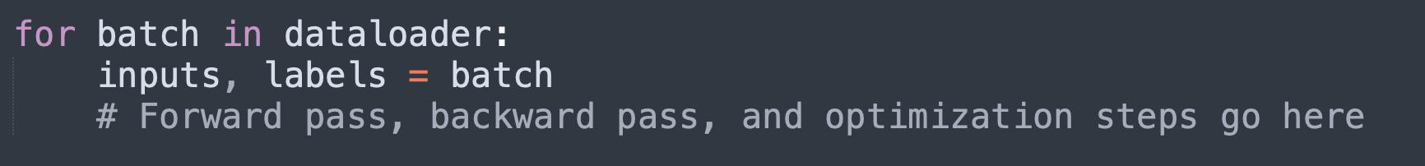
Batch Processing and Iterating Over Datasets
Batch processing is essential for training neural networks efficiently, allowing models to process multiple samples at once.
Batching with DataLoaders
Definition: Batching involves dividing the dataset into smaller, manageable chunks called batches. This reduces the computational load and allows for more stable training.
Example:
Iterating Over Batches
Looping Through Data: In the training loop, you typically iterate over the dataset in batches. Each iteration processes one batch of data.
Example:

Slide 59
Batch Processing and Iterating Over Datasets
Performance Considerations
Data Parallelism: If your system has multiple GPUs, you can leverage data parallelism to distribute batches across GPUs, speeding up the training process.
Optimizing Data Loading: Using multiple workers in the data loader (num_workers) can significantly reduce the time spent on loading data, as it allows for parallel data loading.

Slide 60
Model Evaluation and Validation
Introduction
Evaluating and validating a model is a critical step in the machine learning process, as it ensures that the model not only performs well on the training data but also generalizes to unseen data.
This section covers the essential concepts and techniques needed to evaluate and validate machine learning models effectively.
We'll explore various evaluation metrics such as accuracy, precision, and recall, discuss common validation techniques, and provide strategies for monitoring model performance during training.
Additionally, we'll address how to handle overfitting and underfitting, two common challenges in model training.

Slide 61
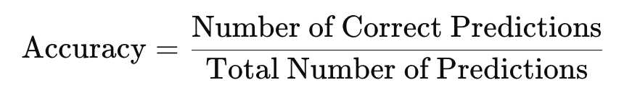
Understanding Evaluation Metrics: Accuracy, Precision, Recall
Evaluation metrics are used to quantify the performance of a model. Different metrics are suited for different types of problems, such as classification or regression.
Accuracy
Definition: Accuracy is the ratio of correctly predicted instances to the total instances. It is a commonly used metric for classification problems where the classes are balanced.
Formula:
Example: If a model correctly classifies 90 out of 100 samples, the accuracy is 90%.
Limitations: Accuracy can be misleading in cases of imbalanced datasets, where one class significantly outnumbers the others.

Slide 62
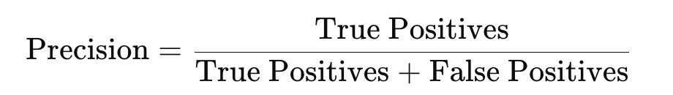
Understanding Evaluation Metrics: Accuracy, Precision, Recall
Precision
Definition: Precision measures the accuracy of the positive predictions made by the model. It is particularly useful when the cost of false positives is high.
Formula:
Example: In a spam detection system, precision would indicate how many of the emails classified as spam were actually spam.
Use Case: Precision is crucial in scenarios like medical diagnosis, where false positives can lead to unnecessary treatments.

Slide 63

Understanding Evaluation Metrics: Accuracy, Precision, Recall
Recall
Definition: Recall, also known as sensitivity or true positive rate, measures the model's ability to correctly identify all positive instances. It is important when the cost of false negatives is high.
Formula:
Example: In a cancer screening test, recall would indicate how many of the actual cancer cases were correctly identified.
Use Case: Recall is vital in applications like disease screening or fraud detection, where missing a positive case could have severe consequences.

Slide 64
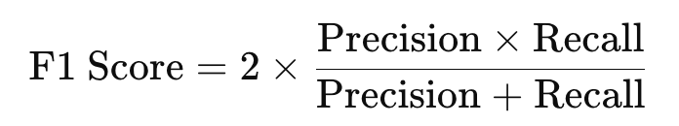
Understanding Evaluation Metrics: Accuracy, Precision, Recall
F1 Score
Definition: The F1 score is the harmonic mean of precision and recall, providing a balanced measure when both metrics are important.
Formula:
Use Case: The F1 score is particularly useful when dealing with imbalanced datasets, offering a single metric that balances precision and recall.

Slide 65
Validation Techniques: Train-Validation Split, K-Fold Cross-Validation
Validation techniques are used to assess how well a model generalizes to unseen data. These techniques help prevent overfitting and ensure that the model's performance is not overly optimistic.
Train-Validation Split
Overview: The dataset is split into two parts: one for training the model and the other for validating it. A common split ratio is 80:20 or 70:30, depending on the size of the dataset.
Process:
Step 1: Split the dataset into training and validation sets.
Step 2: Train the model on the training set.
Step 3: Evaluate the model on the validation set.
Example:
Advantages: Simple to implement and computationally efficient.
Disadvantages: The model's performance might be sensitive to the particular split, especially with small datasets.

Slide 66
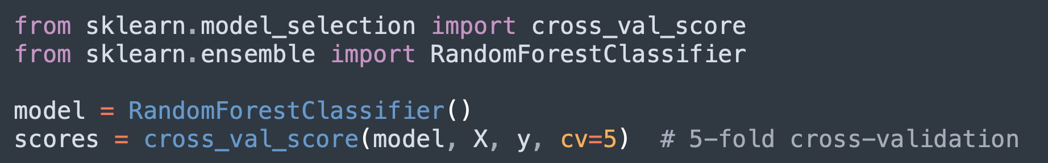
Validation Techniques: Train-Validation Split, K-Fold Cross-Validation
K-Fold Cross-Validation
Overview: K-fold cross-validation involves dividing the dataset into K equal parts (or folds). The model is trained on K-1 folds and validated on the remaining fold. This process is repeated K times, with each fold used exactly once as the validation data.
Process:
Step 1: Split the dataset into K folds.
Step 2: Train the model K times, each time using a different fold as the validation set and the remaining K-1 folds as the training set.
Step 3: Average the performance across all K runs.
Example:
Advantages: Provides a more reliable estimate of model performance, especially with small datasets.
Disadvantages: Computationally expensive, especially for large datasets or complex models.

Slide 67
Validation Techniques: Train-Validation Split, K-Fold Cross-Validation
Stratified K-Fold
Overview: A variation of K-fold cross-validation that preserves the percentage of samples for each class, ensuring that each fold is representative of the overall class distribution.
Use Case: Particularly useful in classification tasks with imbalanced datasets.

Slide 68
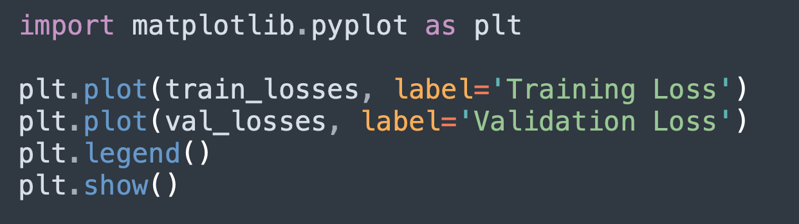
Monitoring Model Performance During Training
It’s essential to monitor the model’s performance throughout the training process to detect issues such as overfitting or underfitting early.
Loss Curves
Overview: Plotting the training and validation loss as a function of epochs helps in visualizing how well the model is learning.
Example:
Interpretation: A steady decrease in training loss with a similar trend in validation loss indicates that the model is learning effectively. If the validation loss starts increasing while the training loss continues to decrease, it may indicate overfitting.

Slide 69
Monitoring Model Performance During Training
Accuracy Curves
Overview: Similar to loss curves, accuracy curves show how the model’s accuracy changes over time for both training and validation datasets.
Early Stopping
Overview: Early stopping is a technique where training is halted once the model's performance on the validation set stops improving. This helps prevent overfitting.
Example: Implement early stopping by monitoring validation loss and stopping training if it doesn't improve for a certain number of epochs.

Slide 70
Handling Overfitting and Underfitting
Overfitting and underfitting are common challenges in machine learning. Overfitting occurs when a model performs well on training data but poorly on unseen data, while underfitting occurs when the model is too simple to capture the underlying patterns in the data.
Understanding Overfitting
Symptoms: The model has very low training loss but high validation loss. It captures noise or irrelevant patterns in the training data.
Solutions:
Regularization: Techniques such as L1 or L2 regularization add a penalty to the loss function, discouraging overly complex models.
Example:

Slide 71
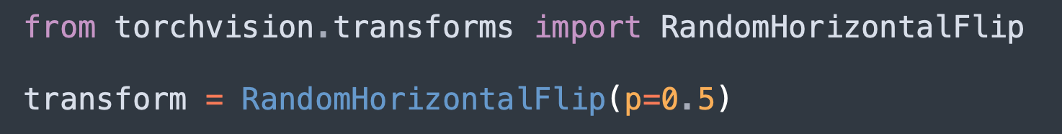
Handling Overfitting and Underfitting
Solutions (contd..):
Dropout: Randomly dropping units during training helps prevent the model from relying too heavily on any particular path.
Example
Data Augmentation: Augmenting the training data with variations (e.g., rotations, flips) can help the model generalize better.
Example:

Slide 72
Handling Overfitting and Underfitting
Understanding Underfitting
Symptoms: The model has high training and validation loss, indicating that it’s too simple to capture the underlying patterns in the data.
Solutions:
Increase Model Complexity: Add more layers or units to the model to make it more expressive.
Train Longer: The model may require more epochs to learn the underlying patterns.
Reduce Regularization: If regularization is too strong, it might be preventing the model from learning effectively.

Slide 73
Advanced Neural Network Architectures
Introduction
As deep learning evolves, so do the architectures used to solve increasingly complex problems.
Traditional feedforward neural networks are often insufficient for tasks involving image recognition, sequential data, or natural language processing.
This section delves into advanced neural network architectures that have revolutionized these domains: Convolutional Neural Networks (CNNs) for image data, Recurrent Neural Networks (RNNs) and Long Short-Term Memory networks (LSTMs) for sequential data, and Transformer Networks for tasks requiring attention mechanisms like language modeling.
Each of these architectures is designed to address specific challenges and leverage unique capabilities, making them powerful tools in the deep learning toolkit.

Slide 74
Convolutional Neural Networks (CNNs)
Convolutional Neural Networks (CNNs) have become the go-to architecture for image-related tasks. They are specifically designed to process data with a grid-like topology, such as images, by taking advantage of the spatial structure of the data.
Convolutional Layers and Filters
Convolutional Layers: The core building block of a CNN is the convolutional layer, which applies a set of filters (or kernels) to the input image. Each filter slides across the input image to produce a feature map, highlighting specific patterns such as edges, textures, or colors.
Example: A 3x3 filter might detect horizontal edges in an image. As it convolves across the image, it creates a new matrix (feature map) where the presence of edges is marked.
Filters (Kernels): Filters are small matrices used to detect specific features in the input data. The values in these filters are learned during the training process.
Stride and Padding: Stride determines how much the filter moves at each step, and padding is used to maintain the original dimensions of the input after convolution.

Slide 75
Convolutional Neural Networks (CNNs)
Pooling Layers: Max Pooling, Average Pooling
Pooling Layers: Pooling layers are used to reduce the spatial dimensions (width and height) of the feature maps, making the computation more efficient and the network more resilient to spatial variations in the input.
Max Pooling: Selects the maximum value in each patch of the feature map, effectively reducing the size while preserving important features.
Example: A 2x2 max pooling layer applied to a feature map would downsample it by selecting the maximum value in each 2x2 region.
Average Pooling: Computes the average of each patch of the feature map, resulting in a smoother and smaller output.

Slide 76
Convolutional Neural Networks (CNNs)
Common CNN Architectures: LeNet, AlexNet, VGG, ResNet
LeNet: One of the earliest CNN architectures, LeNet was developed for digit recognition. It consists of two convolutional layers followed by pooling layers, and then fully connected layers for classification.
Use Case: LeNet is commonly used for recognizing handwritten digits in the MNIST dataset.
AlexNet: AlexNet popularized CNNs by winning the ImageNet competition in 2012. It introduced deeper architectures with more convolutional layers and the use of ReLU activation functions, dropout for regularization, and GPUs for training.
Use Case: AlexNet is used for large-scale image classification tasks.
VGG: VGGNet introduced a very deep architecture with small 3x3 filters, demonstrating that depth (i.e., more layers) significantly improves model performance.
Use Case: VGG is widely used in image classification and feature extraction tasks.
ResNet: ResNet introduced the concept of residual learning, where shortcut connections (identity mappings) skip one or more layers, allowing for much deeper networks without suffering from the vanishing gradient problem.
Use Case: ResNet is used in various computer vision tasks, including image classification, object detection, and segmentation.

Slide 77
Recurrent Neural Networks (RNNs) and LSTMs
Recurrent Neural Networks (RNNs) are designed to handle sequential data, making them suitable for tasks like time series forecasting, natural language processing, and speech recognition.
Understanding Sequential Data
Sequential Data: Unlike independent data points in traditional datasets, sequential data points are dependent on previous ones. Examples include sentences in natural language processing, where the meaning of a word often depends on the preceding words.
Challenge: RNNs are designed to maintain a memory of previous inputs, which is crucial for understanding context in sequences.

Slide 78
Recurrent Neural Networks (RNNs) and LSTMs
LSTM Architecture and Operations
LSTM Networks: Long Short-Term Memory (LSTM) networks are a type of RNN designed to overcome the limitations of standard RNNs, particularly the issue of long-term dependencies. LSTMs use a set of gates (input, forget, and output gates) to control the flow of information, allowing the network to retain relevant information over long sequences.
Gates:
Input Gate: Decides what new information should be added to the cell state.
Forget Gate: Decides what information should be removed from the cell state.
Output Gate: Determines the output based on the cell state and input.
Example: In a language model, LSTMs can be used to predict the next word in a sentence, taking into account the entire preceding context.

Slide 79
Recurrent Neural Networks (RNNs) and LSTMs
Applications in Natural Language Processing and Time Series Analysis
Natural Language Processing (NLP): LSTMs are widely used in tasks such as machine translation, text generation, sentiment analysis, and speech recognition.
Example: In sentiment analysis, an LSTM can analyze the sentiment of a sentence by considering the entire sequence of words.
Time Series Analysis: LSTMs are also effective in forecasting tasks, such as predicting stock prices or weather conditions, where the future values depend on the past trends.
Example: An LSTM can be trained to predict the next day's stock price based on previous prices.

Slide 80
Transformer Networks
Transformer Networks have revolutionized natural language processing by introducing a mechanism that allows the model to focus on specific parts of the input sequence, regardless of their position.
Self-Attention Mechanism
Self-Attention: The self-attention mechanism enables the model to weigh the importance of different words in a sentence when encoding a particular word. This allows the model to capture long-range dependencies more effectively than RNNs or LSTMs.
Example: In a translation model, the word "bank" in "He went to the bank" would have different meanings depending on the surrounding words, and self-attention allows the model to consider these words appropriately.
Scaled Dot-Product Attention: A common implementation of self-attention, where the attention scores are computed as the dot product of query and key vectors, scaled by the square root of the dimension.

Slide 81
Transformer Networks
Transformer Architecture
Overview: The Transformer architecture consists of an encoder and a decoder, both of which are built from self-attention and feedforward layers. The encoder processes the input sequence, while the decoder generates the output sequence, one element at a time.
Multi-Head Attention: The Transformer uses multiple self-attention heads to capture different types of relationships in the data.
Positional Encoding: Since Transformers do not have a built-in mechanism to handle the order of elements in a sequence, positional encodings are added to input embeddings to inject sequence information.
Example: The Transformer architecture is the foundation of models like BERT (Bidirectional Encoder Representations from Transformers) and GPT (Generative Pre-trained Transformer), which are used for tasks ranging from text classification to text generation.

Slide 82
Transformer Networks
Applications in Natural Language Processing
Language Modeling: Transformers are widely used in language modeling tasks, where they generate coherent and contextually relevant text.
Example: GPT-3, a Transformer-based model, can generate human-like text given a prompt, making it useful in content creation and chatbots.
Machine Translation: Transformers have set new benchmarks in machine translation tasks by efficiently capturing the context of the source language to generate accurate translations in the target language.
Example: The Transformer-based model in Google Translate helps produce high-quality translations by understanding the nuances of different languages.

Slide 83
Transfer Learning and Fine-Tuning
Introduction
Training deep learning models from scratch often requires vast amounts of data and computational resources, which may not always be feasible.
Transfer learning offers a solution by allowing you to leverage pre-trained models, which have already learned useful features from large datasets.
By transferring this knowledge to a new task, you can significantly reduce the time and data required to train a model.
In this section, we will explore the concept of transfer learning, how to use pre-trained models from libraries like torchvision and Hugging Face Transformers, and the strategies for fine-tuning models to suit domain-specific tasks.
We will also discuss the differences between feature extraction and fine-tuning strategies.

Slide 84
Introduction to Transfer Learning
Transfer learning is a powerful technique in deep learning where a model developed for one task is reused as the starting point for another task. This approach is particularly useful when you have limited data for the new task but can access a model pre-trained on a large dataset.
Concept of Transfer Learning
Definition: Transfer learning involves taking a model trained on a large dataset (e.g., ImageNet for image classification) and adapting it to a new, related task by either using it as a fixed feature extractor or fine-tuning it on the new dataset.
Example: Using a ResNet model pre-trained on ImageNet to classify medical images by fine-tuning the last few layers on a medical dataset.
Benefits of Transfer Learning
Reduced Training Time: Since the model has already learned useful features, the training process is faster compared to training from scratch.
Improved Performance: Transfer learning can lead to better performance on the target task, especially when the target dataset is small.
Lower Data Requirements: It allows effective model training even with limited labeled data.

Slide 85
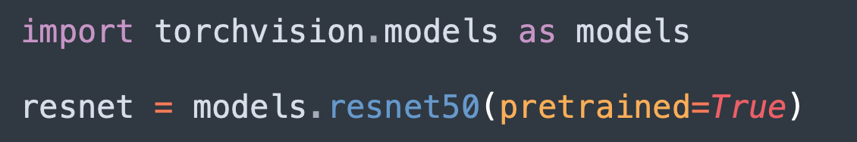
Using Pre-Trained Models from torchvision and Hugging Face Transformers
Pre-trained models are readily available through popular libraries like torchvision for computer vision tasks and Hugging Face Transformers for natural language processing. These models serve as a starting point for transfer learning.
Pre-Trained Models in torchvision
Overview: torchvision offers a variety of pre-trained models for tasks like image classification, object detection, and segmentation. These models are trained on large datasets like ImageNet.
Example: Loading a pre-trained ResNet model:
Applications: You can use these models directly for inference or adapt them to your specific task through fine-tuning.

Slide 86
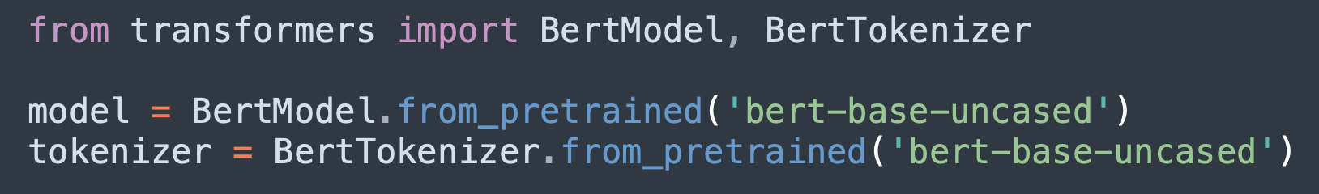
Using Pre-Trained Models from torchvision and Hugging Face Transformers
Pre-Trained Models in Hugging Face Transformers
Overview: Hugging Face Transformers provides access to a wide range of pre-trained models for NLP tasks such as text classification, named entity recognition, and text generation.
Example: Loading a pre-trained BERT model for text classification:
Applications: These models can be fine-tuned for tasks like sentiment analysis, question answering, and machine translation.

Slide 87
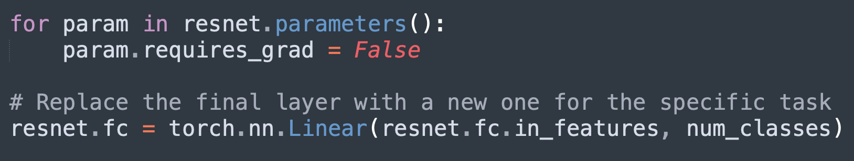
Fine-Tuning Models for Domain-Specific Tasks
Fine-tuning involves further training a pre-trained model on a specific task, allowing it to adapt to the nuances of the new dataset.
Fine-Tuning Process
Overview: Fine-tuning typically involves freezing the early layers of the model (which capture general features) and training the later layers on the new task.
Example: Fine-tuning a ResNet model on a medical imaging dataset by freezing the convolutional layers and training the fully connected layers.
Hyperparameter Tuning: During fine-tuning, it's essential to carefully select hyperparameters such as learning rate and batch size to avoid overfitting, especially if the new dataset is small.

Slide 88
Fine-Tuning Models for Domain-Specific Tasks
Challenges in Fine-Tuning
Overfitting: Fine-tuning on a small dataset can lead to overfitting, where the model becomes too tailored to the training data and fails to generalize to new data.
Catastrophic Forgetting: If the fine-tuning process is too aggressive, the model might "forget" the useful features it learned from the original dataset, leading to degraded performance.

Slide 89
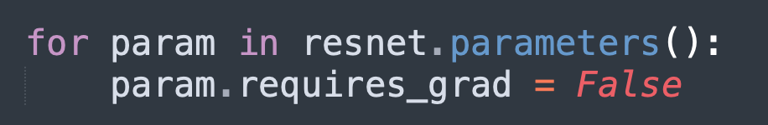
Feature Extraction vs Fine-Tuning Strategies
When using transfer learning, there are two main strategies: feature extraction and fine-tuning. The choice between these strategies depends on the size of your dataset and the similarity between the original and target tasks.
Feature Extraction
Definition: In feature extraction, the pre-trained model is used as a fixed feature extractor, meaning that the weights of the pre-trained model are frozen, and only the final classification layer is trained on the new dataset.
Example: Using a pre-trained ResNet model to extract features from images, then feeding those features into a new classifier trained on your specific dataset.
When to Use: Feature extraction is ideal when you have a small dataset and the new task is similar to the original task the model was trained on.

Slide 90
Feature Extraction vs Fine-Tuning Strategies
Fine-Tuning
Definition: Fine-tuning involves unfreezing some or all of the layers of the pre-trained model and retraining them on the new dataset. This allows the model to adapt more specifically to the new task.
Example: Fine-tuning all layers of a BERT model on a domain-specific text classification task.
When to Use: Fine-tuning is preferred when the new task is somewhat different from the original task, or when you have a larger dataset that can support more extensive retraining.

Slide 91
Handling Complex Data
Introduction
In the realm of deep learning, dealing with complex data types such as images, text, and time series requires specialized techniques and careful preprocessing.
Whether you’re enhancing image datasets with augmentation, preparing text data for natural language processing, or engineering features for time series forecasting, understanding how to handle these data types is crucial.
This section will cover advanced techniques for processing and preparing complex data for use in deep learning models.
We will explore image data augmentation methods, text preprocessing and tokenization strategies, and the unique challenges of handling time series data.

Slide 92
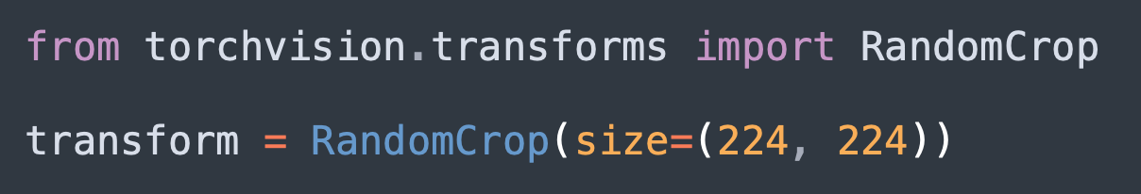
Image Data Augmentation Techniques
Data augmentation is a powerful technique used to artificially increase the size and diversity of an image dataset by applying random transformations. This helps prevent overfitting and improves the generalization ability of deep learning models.
Random Cropping, Flipping, Rotation
Random Cropping: This technique involves randomly selecting a sub-region of an image and cropping it out. It helps the model become more robust to variations in object positioning within images.
Example:

Slide 93
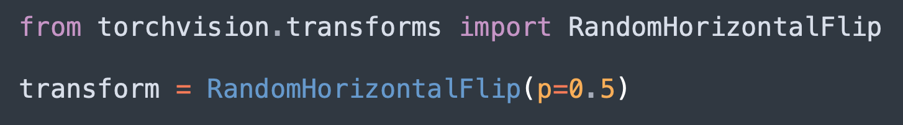
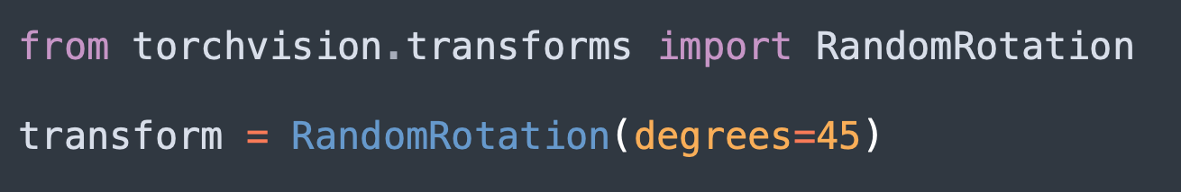
Image Data Augmentation Techniques
Flipping: Random horizontal or vertical flipping of images helps the model learn that the object’s orientation is irrelevant to the classification.
Example:
Rotation: Rotating images by a random degree helps the model become invariant to rotations, which is important for tasks where object orientation varies.
Example:

Slide 94
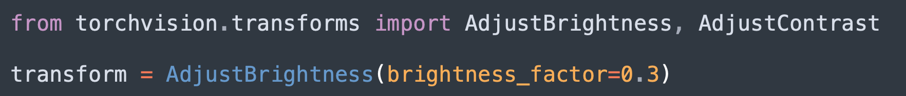
Image Data Augmentation Techniques
Color Jittering, Brightness/Contrast Adjustments
Color Jittering: This technique randomly changes the brightness, contrast, saturation, and hue of an image, simulating different lighting conditions and making the model more robust to such variations.
Example:
Brightness/Contrast Adjustments: Similar to color jittering, this method focuses specifically on altering the brightness and contrast of images.
Example:

Slide 95
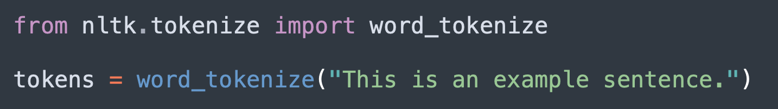
Text Data Preprocessing and Tokenization
Text data requires specific preprocessing steps to convert raw text into a format that can be fed into deep learning models. Tokenization, in particular, is a key step in transforming text into tokens that represent the smallest units of meaning.
Tokenization Methods: Word-Level, Character-Level
Word-Level Tokenization: This method splits text into words, treating each word as a separate token. It’s the most common form of tokenization and is often used in tasks like text classification and sentiment analysis.
Example:
Character-Level Tokenization: This approach breaks text down into individual characters, making it useful for tasks like text generation or language modeling, where finer granularity is required.
Example:

Slide 96
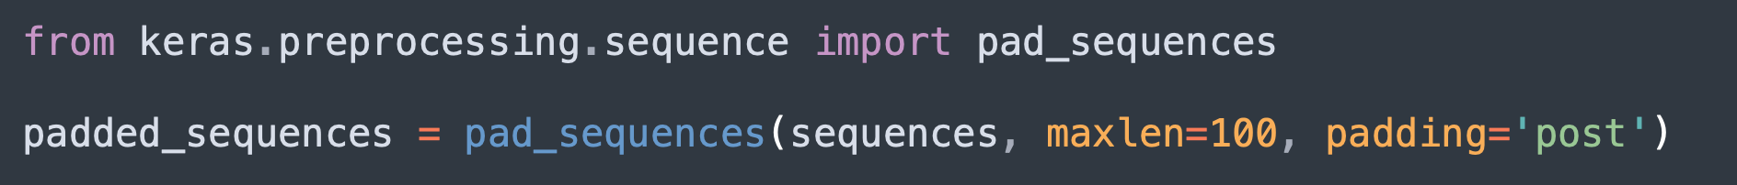
Text Data Preprocessing and Tokenization
Handling Sequences of Variable Length
Padding: Since neural networks require inputs of the same length, shorter sequences are often padded with a special token (e.g., zeros) to match the length of the longest sequence in the batch.
Example:
Truncation: If sequences are too long, they might be truncated to a maximum length to reduce computational load and prevent memory issues.
Example:
Handling Long Sequences: For very long sequences, advanced techniques like attention mechanisms (as in Transformers) can be used to focus on the most relevant parts of the sequence, reducing the need for padding or truncation.

Slide 97
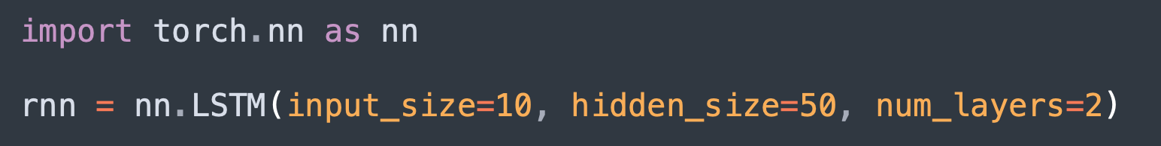
Time Series Data Handling
Time series data presents unique challenges because of its sequential nature and temporal dependencies. Handling this type of data effectively is key for tasks like forecasting, anomaly detection, and temporal pattern recognition.
Temporal Convolutions and Recurrent Architectures
Temporal Convolutions: Convolutional layers can be adapted to process time series data by applying filters over temporal windows, capturing patterns over time.
Example: Temporal Convolutional Networks (TCNs) apply causal convolutions to ensure that the model doesn’t violate the sequence order by incorporating future information.
Recurrent Architectures: Recurrent Neural Networks (RNNs) and Long Short-Term Memory (LSTM) networks are specifically designed for sequential data, maintaining a memory of past inputs through hidden states.
Example:

Slide 98
Time Series Data Handling
Feature Engineering for Time Series Forecasting
Lag Features: Lag features are created by shifting the time series data by one or more time steps, allowing the model to capture temporal dependencies.
Example: Creating a lagged version of a time series to predict the next value based on previous values.
Rolling Statistics: Calculating rolling means, variances, and other statistics over a moving window helps in capturing trends and patterns over time.
Example:
Seasonality and Trends: Identifying and modeling seasonal patterns (e.g., daily, weekly, monthly) and trends in the data is crucial for accurate forecasting.
Example: Decomposing a time series into its trend, seasonality, and residual components.

Slide 99
Model Deployment and Production
Introduction
Once a deep learning model is trained and evaluated, the next critical step is deploying it into production.
Deployment involves not only saving and loading models but also ensuring they can efficiently serve predictions in real-world applications.
This section will guide you through the process of saving and loading models in PyTorch, serializing models for deployment using TorchScript and ONNX, serving models through popular frameworks like Flask, FastAPI, and AWS Lambda, and implementing strategies for model monitoring and versioning in production.
By mastering these techniques, you'll be equipped to take your models from development to real-world deployment with confidence.

Slide 100
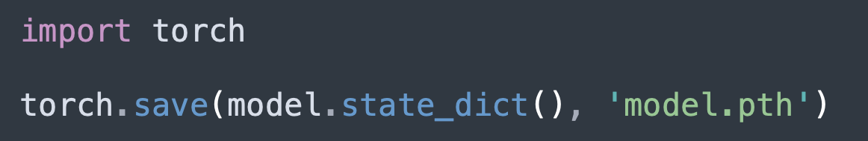
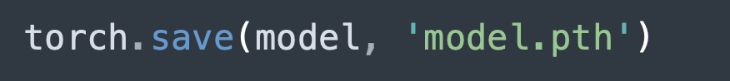
Saving and Loading Models with torch.save() and torch.load()
Saving and loading models are fundamental operations that allow you to preserve the state of a trained model and reuse it later for inference or further training.
Saving Models
State Dictionary: In PyTorch, the recommended way to save a model is by saving its state dictionary, which contains the model's parameters (weights and biases).
Example:
Entire Model: While saving the entire model is possible, it is less flexible and not recommended for most use cases, especially when dealing with dynamic computational graphs.
Example:

Slide 101

Saving and Loading Models with torch.save() and torch.load()
Loading Models
Loading State Dictionary: To load a model, you need to first initialize the model architecture and then load the saved state dictionary into it.
Example:
Loading Entire Model: If you saved the entire model, you can load it directly, though this method is less flexible.
Example:

Slide 102
Model Serialization and Deployment with TorchScript and ONNX
For deploying models in production, you need to serialize them in a format that can be efficiently executed in various environments.
TorchScript
Overview: TorchScript is an intermediate representation of a PyTorch model that can be optimized and executed in a production environment without requiring a Python runtime.
Scripting: Convert a PyTorch model to TorchScript using scripting, which automatically converts the model:
Tracing: Alternatively, you can trace a model that has a fixed input size to TorchScript:
Deployment: TorchScript models can be deployed to environments like mobile devices, edge devices, or cloud servers where a full Python runtime might not be available.

Slide 103
Model Serialization and Deployment with TorchScript and ONNX
ONNX (Open Neural Network Exchange)
Overview: ONNX is an open standard for representing machine learning models, allowing models trained in PyTorch to be deployed in a variety of platforms and runtimes, such as TensorRT or ONNX Runtime.
Exporting to ONNX: Convert a PyTorch model to the ONNX format:
Deployment: ONNX models can be deployed in environments that support ONNX, making it easier to integrate with other frameworks and tools beyond PyTorch.

Slide 104

Serving PyTorch Models with Flask, FastAPI, and AWS Lambda
Serving a model involves setting up an API that can receive data, pass it to the model for prediction, and return the result. Various frameworks can help with this process.
Serving with Flask
Overview: Flask is a lightweight web framework that can be used to create a simple API for serving PyTorch models.
Example:

Slide 105

Serving PyTorch Models with Flask, FastAPI, and AWS Lambda
Serving with FastAPI
Overview: FastAPI is a modern, fast web framework that is well-suited for building APIs with automatic documentation and validation.
Example:

Slide 106
Serving PyTorch Models with Flask, FastAPI, and AWS Lambda
Serving with AWS Lambda
Overview: AWS Lambda is a serverless computing service that lets you run code without provisioning servers. You can deploy a PyTorch model using Lambda to create a scalable and cost-effective model serving endpoint.
Steps:
Package your model and code.
Deploy to AWS Lambda using a tool like AWS SAM or the Serverless Framework.
Integrate with API Gateway to create an HTTP endpoint for serving predictions.

Slide 107
Model Monitoring and Versioning in Production
Once deployed, models in production must be monitored for performance and managed through versioning to ensure reliability and continuous improvement.
Model Monitoring
Importance: Monitoring is crucial for detecting issues like model drift, where the model's performance degrades over time due to changes in data patterns.
Metrics: Track metrics such as prediction accuracy, latency, error rates, and resource utilization.
Tools: Use monitoring tools like Prometheus, Grafana, or specialized AI monitoring platforms like Seldon or Neptune.ai to keep track of these metrics.
Model Versioning
Overview: Versioning allows you to manage multiple versions of a model, enabling rollback to previous versions if needed, and A/B testing of different models.
Techniques: Use model registries and versioning tools like MLflow, DVC (Data Version Control), or AWS SageMaker Model Registry.
Deployment Strategy: Implement canary deployments or blue-green deployments to safely transition between model versions in production.

Slide 108
Debugging and Troubleshooting
Introduction
Even with well-structured code, issues can arise during the development of deep learning models.
Debugging and troubleshooting are essential skills for identifying and resolving errors, improving model stability, and optimizing performance.
In this section, we will explore common errors and warnings in PyTorch, effective debugging techniques, strategies for handling numerical stability issues like NaNs and infinities, and tools for profiling and optimizing PyTorch code.
By mastering these skills, you can ensure your models run smoothly and efficiently in both development and production environments.

Slide 109
Understanding Common PyTorch Errors and Warnings
PyTorch users often encounter various errors and warnings, especially when experimenting with complex models or data pipelines. Understanding these messages is crucial for quickly diagnosing and fixing issues.
Common Errors
Shape Mismatch Errors: These occur when operations are performed on tensors with incompatible shapes. Common examples include trying to add tensors of different dimensions or incorrectly defining model layers.
Example:
Solution: Check the shapes of the tensors involved using tensor.shape and ensure they are compatible for the intended operation.

Slide 110
Understanding Common PyTorch Errors and Warnings
Type Errors: PyTorch operations are sensitive to tensor data types. A common mistake is performing operations between tensors of different types, such as float32 and int64.
Example:
Solution: Ensure tensors are of the same type using tensor.type() and convert them if necessary using tensor.float() or tensor.long().
CUDA Errors: These errors are related to GPU usage and occur when operations are performed on tensors that are not on the same device or when there is insufficient GPU memory.
Example:
Solution: Free up memory by deleting unnecessary variables with del, use smaller batch sizes, or move some tensors to the CPU using tensor.cpu().

Slide 111
Understanding Common PyTorch Errors and Warnings
Common Warnings
UserWarnings: PyTorch often issues warnings when it detects potentially problematic operations, such as using deprecated features or inefficient methods.
Example:
Solution: Pay attention to warnings and update your code to comply with the latest recommended practices.
DeprecationWarnings: These warnings inform you that a particular feature or function will be removed in a future version of PyTorch.
Solution: Replace deprecated features with their modern equivalents as suggested in the warning message.

Slide 112


Debugging Techniques: Printing Tensors, Using PyTorch Debugger (pdb)
Effective debugging techniques are essential for identifying and resolving issues in your code.
Printing Tensors
Overview: One of the simplest yet most effective debugging techniques is printing the values and shapes of tensors at various points in your code. This helps verify that operations are producing the expected results.
Example:
Inspecting Gradients: You can also print the gradients of tensors after the backward pass to ensure they are being computed correctly.
Example:

Slide 113

Debugging Techniques: Printing Tensors, Using PyTorch Debugger (pdb)
Using PyTorch Debugger (pdb)
Overview: PyTorch can be debugged using Python’s built-in pdb debugger, which allows you to set breakpoints, step through code, and inspect variables.
Setting a Breakpoint: Insert import pdb; pdb.set_trace() at the point where you want to start debugging. The execution will pause, allowing you to inspect the environment.
Example:
Common Commands:
n (next): Execute the next line of code.
c (continue): Continue execution until the next breakpoint.
q (quit): Exit the debugger.
p variable_name: Print the value of a variable.

Slide 114

Handling Numerical Stability Issues: NaNs, Infinities
Numerical stability is a common concern in deep learning, where certain operations can lead to NaNs (Not a Number) or infinite values, causing the model to fail.
Common Causes of NaNs and Infinities
Exploding Gradients: Gradients that grow exponentially during backpropagation can lead to NaNs or infinities in the model's parameters.
Solution: Use gradient clipping to limit the size of the gradients.
Division by Zero: Certain operations, like division or logarithms, can produce NaNs or infinities when the input is zero or negative.
Solution: Add a small epsilon value to the denominator to prevent division by zero.
Overflow in Exponentials: Exponential functions can quickly grow to very large values, leading to overflow.
Solution: Use the torch.clamp() function to limit the range of inputs.

Slide 115


Handling Numerical Stability Issues: NaNs, Infinities
Detecting and Handling NaNs and Infinities
NaN Detection: Use the torch.isnan() function to detect NaNs in tensors.
Example:
Infinity Detection: Similarly, torch.isinf() can be used to detect infinite values.
Example:
Debugging NaNs: If NaNs or infinities are detected, backtrack through your operations to find where they first appear and modify the operations to ensure numerical stability.

Slide 116

Profiling and Optimizing PyTorch Code
Profiling and optimizing your PyTorch code is crucial for improving performance, especially when training large models on substantial datasets.
Profiling with torch.profiler
Overview: PyTorch’s torch.profiler module provides tools for profiling model performance, identifying bottlenecks, and understanding how different parts of your code execute.
Example:
Insights: Profiling can reveal which operations are taking the most time, whether your model is effectively utilizing the GPU, and where you might have inefficiencies in your code.

Slide 117

Profiling and Optimizing PyTorch Code
Code Optimization Techniques
Batching: Process data in batches rather than individually to take full advantage of GPU parallelism.
Example: Instead of processing one image at a time, use a batch of 32 images to maximize GPU utilization.
Mixed Precision Training: Use mixed precision training to reduce memory usage and increase computational speed by using 16-bit floating-point numbers where possible.
Example:
Avoiding Python Loops: Replace Python loops with PyTorch operations whenever possible to leverage the power of vectorization and GPU acceleration.
Example: Instead of looping through tensors to add them, use tensor.sum(dim=0) for efficient computation.

Slide 118
Distributed Training and Performance Optimization
Introduction
As deep learning models grow in complexity and size, the need for efficient training methods becomes increasingly important.
Distributed training allows you to scale your training across multiple GPUs or even multiple nodes, significantly reducing training time.
Additionally, techniques like gradient accumulation, mixed precision training, and various performance optimizations can help you make the most of your hardware resources.
This section will guide you through the essentials of distributed training using PyTorch's DistributedDataParallel, as well as strategies for optimizing model performance during training.
By the end of this section, you will be equipped with the tools and knowledge to train large models efficiently and effectively.

Slide 119
Distributed Training with torch.nn.parallel.DistributedDataParallel
Distributed training enables you to leverage multiple GPUs or nodes to train your models faster. PyTorch's torch.nn.parallel.DistributedDataParallel (DDP) is the recommended way to distribute your training across multiple devices.
Introduction to DistributedDataParallel
Overview: DDP synchronizes gradients and updates model parameters across multiple processes running on different GPUs or nodes. This ensures that each GPU contributes to the training process, effectively parallelizing the workload.
Example: In a multi-GPU setup, each GPU processes a subset of the training data, and DDP ensures that all GPUs stay in sync by averaging gradients during backpropagation.

Slide 120


Distributed Training with torch.nn.parallel.DistributedDataParallel
Setting Up DDP
Step 1: Initialize the process group for communication between GPUs.
Example:
Step 2: Wrap your model with DistributedDataParallel.
Example:
Step 3: Ensure that each process is assigned a specific GPU using the local_rank argument.
Example:

Slide 121
Distributed Training with torch.nn.parallel.DistributedDataParallel
Best Practices for DDP
DataLoader with DistributedSampler: Use torch.utils.data.distributed.DistributedSampler to ensure that each GPU receives a different subset of the data, preventing overlap and ensuring efficient use of the dataset.
Example:
Gradient Synchronization: DDP automatically synchronizes gradients across all processes, so you don’t need to manually handle gradient averaging.
Handling Multiple Nodes: For multi-node setups, ensure that the init_method in init_process_group is set up correctly to allow nodes to communicate with each other.

Slide 122

Gradient Accumulation and Gradient Clipping
Training large models on limited GPU memory can be challenging. Gradient accumulation and gradient clipping are techniques that help manage memory and ensure stable training.
Gradient Accumulation
Overview: Gradient accumulation involves accumulating gradients over multiple forward passes before performing a backward pass and optimizer step. This allows you to effectively simulate a larger batch size than what your GPU memory can handle.
Example:
When to Use: Use gradient accumulation when your desired batch size exceeds the available GPU memory, allowing you to train with larger effective batch sizes.

Slide 123
Gradient Accumulation and Gradient Clipping
Gradient Clipping
Overview: Gradient clipping involves capping the gradients to a maximum value to prevent them from becoming too large, which can cause unstable training or gradient explosions.
Example:
When to Use: Gradient clipping is particularly useful in training deep neural networks or recurrent models where gradients can grow exponentially during backpropagation.

Slide 124

Mixed Precision Training with NVIDIA Apex
Mixed precision training leverages the capabilities of modern GPUs by using both 16-bit and 32-bit floating-point operations, leading to faster computation and reduced memory usage.
Introduction to Mixed Precision
Overview: Mixed precision training allows you to train models faster by using 16-bit floats (FP16) where possible, while still maintaining the precision of 32-bit floats (FP32) for critical operations. This is especially beneficial on NVIDIA GPUs that support Tensor Cores, which are optimized for FP16 operations.
Setting Up Mixed Precision Training
Using NVIDIA Apex: NVIDIA’s Apex library provides tools for easy implementation of mixed precision training in PyTorch.
Example:
Automatic Loss Scaling: Apex automatically scales the loss to prevent underflow when using FP16, ensuring stable training.

Slide 125
Mixed Precision Training with NVIDIA Apex
Best Practices
Choosing Optimization Level: Apex offers different optimization levels (O0, O1, O2, O3) that balance between speed and precision. Start with O1 as it offers a good trade-off between performance and stability.
Monitoring for NaNs: Mixed precision training can sometimes lead to numerical instability. Monitor your training for NaNs and infinities, and use gradient clipping if necessary.

Slide 126


Performance Optimization Techniques: Parallelism, Asynchronous Processing
Optimizing performance in PyTorch involves making the most of your hardware resources through parallelism and asynchronous processing.
Parallelism
Data Parallelism: Distributes the data across multiple GPUs, allowing each GPU to process a portion of the data in parallel.
Example:
Model Parallelism: Splits the model itself across multiple GPUs, useful for very large models that don’t fit into a single GPU’s memory.
Example:

Slide 127
Performance Optimization Techniques: Parallelism, Asynchronous Processing
Asynchronous Processing
Asynchronous Data Loading: Using multiple workers in DataLoader allows for asynchronous data loading, reducing the time your GPU spends idle.
Example:
Asynchronous CUDA Operations: PyTorch operations on CUDA tensors are asynchronous by default, allowing the GPU to perform computations while the CPU prepares the next batch of data.
Profiling and Optimizing
Profiler: Use PyTorch’s profiler to identify bottlenecks in your code and optimize accordingly.
Example:
Memory Management: Monitor GPU memory usage with torch.cuda.memory_summary() and optimize by clearing caches or using torch.no_grad() in inference mode to reduce memory consumption.

Slide 128
Custom Layers and Loss Functions
Introduction
While PyTorch provides a wide range of built-in layers, loss functions, and activation functions, there are times when you need to customize these components to fit specific needs or experiment with novel architectures.
This section covers how to create custom neural network layers and loss functions using torch.nn.Module, implement advanced activation functions, and apply regularization techniques to prevent overfitting.
By mastering these concepts, you'll gain greater flexibility in designing and optimizing deep learning models tailored to your specific tasks.

Slide 129

Creating Custom Neural Network Layers with torch.nn.Module
Custom layers allow you to implement unique operations that are not available in PyTorch's standard library, providing more control over the model architecture.
Subclassing torch.nn.Module
Overview: To create a custom layer, subclass torch.nn.Module and implement the __init__() method to define the layer's parameters and the forward() method to define the computation.
Example:

Slide 130


Creating Custom Neural Network Layers with torch.nn.Module
Usage: Once defined, the custom layer can be used like any other PyTorch layer in a neural network.
Example:
Parameter Initialization
Custom Initialization: You can customize the initialization of layer parameters using methods such as torch.nn.init.
Example:

Slide 131


Implementing Custom Loss Functions and Metrics
Custom loss functions and metrics are essential when built-in options do not fit your specific problem or when you want to introduce novel evaluation criteria.
Creating Custom Loss Functions
Overview: To create a custom loss function, define a new function or subclass torch.nn.Module and implement the forward() method to calculate the loss.
Example:
Usage: The custom loss function can be used like any other loss function in your training loop.
Example

Slide 132


Implementing Custom Loss Functions and Metrics
Implementing Custom Metrics
Overview: Metrics evaluate the performance of your model on validation or test data. You can create custom metrics by defining a function that compares predictions with the ground truth.
Example:
Usage: Use custom metrics during model evaluation to gain insights beyond standard metrics like accuracy or loss.
Example:

Slide 133


Advanced Activation Functions: Swish, Mish, GELU
Activation functions play a crucial role in introducing non-linearity into neural networks. While ReLU is the most common, advanced activation functions like Swish, Mish, and GELU can offer performance improvements in certain models.
Swish
Overview: Swish is an activation function defined as f(x) = x * sigmoid(x). It has been shown to perform better than ReLU in some deep networks.
Example:
Usage: Replace ReLU with Swish in your model architecture where appropriate.
Example:

Slide 134


Advanced Activation Functions: Swish, Mish, GELU
Mish
Overview: Mish is defined as f(x) = x * tanh(softplus(x)), where softplus(x) = log(1 + exp(x)). Mish has been found to improve the performance of various architectures, especially in computer vision tasks.
Example:
Usage: Mish can be used in place of ReLU or other activation functions in your model.
Example:

Slide 135


Advanced Activation Functions: Swish, Mish, GELU
GELU (Gaussian Error Linear Unit)
Overview: GELU is defined as f(x) = x * 0.5 * (1 + erf(x / sqrt(2))), where erf is the error function. It is used in models like BERT and has shown improved convergence properties in NLP tasks.
Example:
Usage: GELU is often used in transformer models and can be substituted for other activations in models requiring smooth and non-linear behavior.
Example:

Slide 136


Regularization Techniques: Dropout, Weight Decay
Regularization is crucial for preventing overfitting, especially in complex models with a large number of parameters.
Dropout
Overview: Dropout is a regularization technique that randomly sets a fraction of the input units to zero during training, preventing the model from becoming too dependent on any particular node.
Example:
Usage: Dropout is typically applied to fully connected layers in neural networks.
Example:

Slide 137
Regularization Techniques: Dropout, Weight Decay
Weight Decay
Overview: Weight decay (L2 regularization) penalizes large weights by adding a term to the loss function that is proportional to the sum of the squares of the weights.
Example:
Usage: Weight decay is applied during optimization and helps prevent overfitting by discouraging overly complex models.
Example: Applying weight decay in the optimizer:python

Slide 138
Research-oriented Techniques
Introduction
In the rapidly evolving field of machine learning, conducting robust and reproducible research is crucial for ensuring that your findings can be validated and built upon by others.
This section delves into the essential techniques that support research-oriented workflows, including ensuring reproducibility in experiments, tracking experiments with specialized tools, optimizing hyperparameters, and staying current with the latest research.
By mastering these techniques, you will be better equipped to conduct high-quality research that contributes meaningfully to the machine learning community.

Slide 139
Reproducibility in Machine Learning Experiments
Reproducibility is a cornerstone of scientific research, and in machine learning, it involves ensuring that your experiments can be reliably repeated with the same results.
Importance of Reproducibility
Overview: Reproducibility allows other researchers to verify your results, compare approaches, and build on your work. Inconsistent results can undermine the credibility of your findings and hinder progress in the field.
Challenges: Machine learning experiments can be difficult to reproduce due to factors like random initializations, non-deterministic hardware operations (e.g., GPU computations), and inconsistent data preprocessing.

Slide 140

Reproducibility in Machine Learning Experiments
Techniques for Ensuring Reproducibility
Set Random Seeds: By setting random seeds for libraries like NumPy, PyTorch, and random, you can control the randomness in your experiments.
Example:

Slide 141

Reproducibility in Machine Learning Experiments
Documenting Dependencies: Use tools like pip freeze or conda env export to document the exact versions of libraries used in your environment.
Example:
Control Hardware Variations: Where possible, run experiments on the same hardware, or at least document the hardware used, as different GPUs or CPUs can lead to slightly different results due to hardware-specific optimizations.

Slide 142
Experiment Tracking with Tools like Neptune, Weights & Biases
Experiment tracking is crucial for organizing, comparing, and sharing the results of different runs, especially when working on complex projects with multiple variables.
Introduction to Experiment Tracking
Overview: Experiment tracking tools help manage and log the details of your experiments, such as hyperparameters, training metrics, model versions, and code changes. This ensures that you can trace back the steps that led to specific results.
Benefits: These tools facilitate collaboration, reproducibility, and easier debugging by providing a clear history of your experiments.

Slide 143

Experiment Tracking with Tools like Neptune, Weights & Biases
Neptune.ai
Overview: Neptune is an experiment tracking and model registry tool that allows you to log and compare experiments in real-time, making it easier to manage your research projects.
Example:
Features: Neptune offers features like dashboard visualization, automated logging, and integration with various machine learning frameworks.

Slide 144

Experiment Tracking with Tools like Neptune, Weights & Biases
Weights & Biases (W&B)
Overview: W&B is another popular experiment tracking tool that provides real-time visualization of your model training, hyperparameter tuning, and version control.
Example:
Features: W&B integrates with PyTorch and other frameworks, offering rich visualizations, collaborative reporting, and easy sharing of experiment results.

Slide 145

Hyperparameter Tuning Strategies: Grid Search, Random Search, Bayesian Optimization
Hyperparameter tuning is critical for optimizing the performance of machine learning models. Different strategies offer various trade-offs between exploration and efficiency.
Grid Search
Overview: Grid search systematically explores a predefined set of hyperparameters by evaluating all possible combinations. While exhaustive, it can be computationally expensive.
Example:
When to Use: Grid search is ideal when you have a small number of hyperparameters and values to explore.

Slide 146

Hyperparameter Tuning Strategies: Grid Search, Random Search, Bayesian Optimization
Random Search
Overview: Random search selects hyperparameters randomly from a specified range, offering a more efficient alternative to grid search by not evaluating every possible combination.
Example:
When to Use: Random search is more efficient than grid search when you have many hyperparameters or a large search space.

Slide 147

Hyperparameter Tuning Strategies: Grid Search, Random Search, Bayesian Optimization
Bayesian Optimization
Overview: Bayesian optimization is a more sophisticated method that models the performance of hyperparameters with a probabilistic model and chooses the next set of parameters to evaluate based on expected improvement.
Example:
When to Use: Bayesian optimization is highly efficient for complex models with many hyperparameters, as it intelligently explores the search space to find optimal values faster.

Slide 148
Staying Updated with Research Papers and Conferences
The field of machine learning is fast-paced, with new research being published daily. Staying updated with the latest advancements is crucial for researchers and practitioners alike.
Following Research Papers
ArXiv and Google Scholar: These platforms are essential for discovering and following the latest research papers. Setting up alerts for specific topics can help you stay informed.
ArXiv: A repository of preprints where researchers publish their latest work before it’s peer-reviewed.
Google Scholar: Provides citations, related papers, and the ability to create alerts for new papers in your field.
RSS Feeds and Email Alerts: Use RSS feeds or email alerts to automatically receive updates on new papers in your areas of interest.
Example: Set up a Google Scholar alert for “deep learning” or “transformer networks.”

Slide 149
Staying Updated with Research Papers and Conferences
Participating in Conferences
Top Conferences: Major conferences like NeurIPS, ICML, and CVPR are where leading researchers present their latest work. Attending these conferences, whether in person or virtually, provides valuable insights and networking opportunities.
Example:
NeurIPS: Focuses on machine learning and computational neuroscience.
ICML: Covers a broad range of topics in machine learning.
CVPR: Specializes in computer vision and pattern recognition.
Workshops and Tutorials: Conferences often feature workshops and tutorials on cutting-edge topics, providing hands-on learning opportunities and insights into emerging trends.

Slide 150
Integration with Other Libraries
Introduction
One of the strengths of PyTorch is its flexibility and ease of integration with other popular libraries in the machine learning ecosystem.
Whether you’re combining the strengths of PyTorch and TensorFlow, leveraging OpenCV for advanced computer vision tasks, or utilizing natural language processing libraries like spaCy and NLTK, PyTorch’s interoperability makes it a powerful tool for a wide range of applications.
This section explores how to integrate PyTorch with other libraries, enhancing your ability to build complex, multi-functional models and workflows.

Slide 151
Interoperability between PyTorch and TensorFlow/Keras Models
While PyTorch and TensorFlow/Keras are often seen as competing frameworks, there are situations where you might want to leverage models or components from both ecosystems. Understanding how to bridge the gap between them can be invaluable.
Converting Models between PyTorch and TensorFlow
Overview: Converting models between PyTorch and TensorFlow/Keras allows you to reuse existing models, take advantage of specific features of each framework, and deploy models in environments that prefer one framework over the other.
Using ONNX for Conversion: ONNX (Open Neural Network Exchange) is an open format that allows you to convert models between different frameworks, including PyTorch and TensorFlow.
Example: Converting a PyTorch model to ONNX and then to TensorFlow: (Next Slide)
Using Keras to Load and Convert Models:
You can also load Keras models in PyTorch by manually converting weights and architectures or using libraries like onnx2keras.

Slide 152

Interoperability between PyTorch and TensorFlow/Keras Models
Example: Converting a PyTorch model to ONNX and then to TensorFlow:

Slide 153
Interoperability between PyTorch and TensorFlow/Keras Models
Using PyTorch Models in TensorFlow/Keras
Embedding PyTorch within TensorFlow Workflows: Sometimes, it’s beneficial to run a PyTorch model as part of a TensorFlow/Keras pipeline. This can be achieved by exporting the PyTorch model to ONNX, and then importing it into TensorFlow.
Example: Use tf.keras.Model to load an ONNX model and integrate it into a larger TensorFlow model.
Mixed Environments: In complex workflows, PyTorch and TensorFlow models can be used together, each handling different parts of the pipeline. This is particularly useful in research environments where flexibility is key.

Slide 154

Using PyTorch with OpenCV for Computer Vision Tasks
OpenCV is a widely used library for computer vision tasks, and combining it with PyTorch allows you to build powerful models that leverage both image processing and deep learning.
Preprocessing Images with OpenCV
Overview: OpenCV provides a rich set of tools for image manipulation, which can be used to preprocess images before feeding them into a PyTorch model.
Example: Reading and processing images with OpenCV:

Slide 155
Using PyTorch with OpenCV for Computer Vision Tasks
Preprocessing Images with OpenCV (cont…)
Common Preprocessing Techniques:
Resizing: Use cv2.resize() to resize images.
Normalization: Normalize pixel values using OpenCV or PyTorch’s transforms.Normalize.
Real-Time Inference with OpenCV and PyTorch
Overview: OpenCV’s real-time video processing capabilities can be combined with PyTorch models to perform tasks like real-time object detection or face recognition.
Example: Real-time object detection with a PyTorch model: (next slide)
Edge Computing: Combining PyTorch and OpenCV on edge devices, such as Raspberry Pi, enables real-time inference for IoT applications.

Slide 156

Using PyTorch with OpenCV for Computer Vision Tasks
Example: Real-time object detection with a PyTorch model:

Slide 157

Integration with Natural Language Processing Libraries: spaCy, NLTK
PyTorch’s flexibility makes it easy to integrate with popular NLP libraries like spaCy and NLTK, enhancing your ability to build and deploy sophisticated NLP models.
Using PyTorch with spaCy
Overview: spaCy is a powerful NLP library that offers pre-trained models for tasks like tokenization, named entity recognition, and dependency parsing. Combining spaCy with PyTorch allows you to preprocess text data efficiently and build custom NLP models.
Example: Tokenizing text with spaCy and using it in a PyTorch model:
Text Preprocessing: Use spaCy for advanced text preprocessing tasks, such as lemmatization and part-of-speech tagging, before feeding the processed text into a PyTorch model.

Slide 158

Integration with Natural Language Processing Libraries: spaCy, NLTK
Using PyTorch with NLTK
Overview: NLTK (Natural Language Toolkit) is a comprehensive library for building Python programs to work with human language data. It provides tools for text processing, tokenization, and more.
Example: Tokenizing and processing text with NLTK:
Integrating with PyTorch Models: NLTK can be used to preprocess text data, generate features, and then feed these features into a PyTorch model for training or inference.

Slide 159
Contributing to PyTorch and Community Engagement
Introduction
PyTorch is an open-source deep learning framework that thrives on the contributions of its vibrant community.
Contributing to PyTorch not only helps the ecosystem grow but also enables developers to engage with cutting-edge technologies and collaborate with experts worldwide.
This section covers the steps involved in contributing to PyTorch, including understanding its contribution guidelines, contributing bug fixes or new features, and engaging with the PyTorch community through forums, mailing lists, and social media.
By participating in the development of PyTorch, you can have a meaningful impact on the future of the framework while building your skills and professional network.

Slide 160
Understanding PyTorch's Contribution Guidelines and Codebase
Before contributing to PyTorch, it's essential to familiarize yourself with the contribution guidelines and the structure of the PyTorch codebase.
PyTorch's Contribution Guidelines
Overview: PyTorch maintains a set of contribution guidelines that outline the process for submitting changes, whether they be bug fixes, documentation improvements, or new features. Following these guidelines ensures that contributions are in line with the project's standards and are reviewed efficiently.
Example: You can find the contribution guidelines in the official PyTorch GitHub repository in the CONTRIBUTING.md file.
Steps for Contributions:
Fork the Repository: Start by forking the PyTorch repository to your GitHub account, which gives you your own copy of the codebase to work on.
Create a Branch: Create a new branch for each contribution. This keeps your changes isolated from the main repository and allows for easier collaboration and review.
Code and Test: Make your changes, write tests, and ensure your code passes all existing tests by running the test suite.
Submit a Pull Request (PR): Once your changes are ready, submit a pull request to the PyTorch repository for review.

Slide 161
Understanding PyTorch's Contribution Guidelines and Codebase
Navigating the PyTorch Codebase
Overview: The PyTorch codebase is large and well-organized, with different directories corresponding to various components such as core tensor operations, neural network modules, and distributed training tools. Understanding this structure is crucial for making contributions.
Example:
torch: Contains the core functionalities of PyTorch, such as tensors, autograd, and utilities.
torch.nn: Contains modules related to neural networks, including layers, loss functions, and optimizers.
torch.distributed: Contains tools for distributed and parallel training.
Documentation: PyTorch’s documentation is extensive, and understanding it is key to contributing effectively. The codebase also includes docstrings and inline comments that explain how various parts of the framework work.

Slide 162
Contributing Bug Fixes, Documentation, and New Features
Contributing to PyTorch can take many forms, from fixing small bugs to implementing new features or improving the framework’s documentation.
Contributing Bug Fixes
Overview: Bug fixes are often a great starting point for new contributors, as they require less domain knowledge and are usually well-scoped. To find bugs to work on, check the GitHub issues page, where bugs are often tagged with good first issue for beginners.
Steps:
Search for a bug that aligns with your skills.
Comment on the issue to let maintainers know you're working on it.
Write a fix, add relevant tests, and submit a pull request.
Improving Documentation
Overview: High-quality documentation is crucial for the usability of open-source projects. You can contribute by improving existing documentation, writing new tutorials, or adding explanations to under-documented sections.
Example: If you notice unclear documentation or missing sections in the torch.nn module, you can update the docstrings or contribute a tutorial that explains its usage in detail.
Process: Contributions to the documentation are handled similarly to code contributions, where changes are submitted as pull requests. Always ensure that your documentation contributions are clear, concise, and aligned with PyTorch's documentation style.

Slide 163
Contributing Bug Fixes, Documentation, and New Features
Adding New Features
Overview: Contributing new features or extending existing ones is more complex and requires a deep understanding of PyTorch’s architecture. New features must align with PyTorch’s development roadmap and be discussed with the core team before implementation.
Steps:
Propose the feature by opening a GitHub issue or discussing it on the forums.
Wait for feedback and iterate on the design.
Implement the feature, write comprehensive tests, and submit a PR.
Best Practices: Follow PyTorch’s style guide, ensure backward compatibility, and include unit tests for all new features. Also, document the feature in the user-facing documentation.

Slide 164
Engaging with the PyTorch Community: Forums, Mailing Lists, Social Media
Engagement with the PyTorch community helps you stay updated on the latest developments, seek help when needed, and contribute to discussions on best practices and new features.
PyTorch Forums
Overview: The PyTorch Forums are the central hub for community discussions, where users and contributors ask questions, share insights, and discuss bugs or feature requests.
Link: https://discuss.pytorch.org/
How to Engage:
Ask Questions: If you’re working on a challenging problem or need clarification on specific PyTorch features, the forums are a great place to seek help.
Answer Questions: Contribute to the community by answering questions and helping others solve their issues.
Participate in Discussions: Join discussions about upcoming releases, research papers, or new features.
PyTorch Mailing Lists
Overview: PyTorch’s mailing lists allow for more formal announcements and discussions about development progress, release cycles, and important updates. They’re useful for staying informed about larger developments in the project.
How to Subscribe: Mailing lists are often linked directly from the PyTorch website or GitHub repository.

Slide 165
Engaging with the PyTorch Community: Forums, Mailing Lists, Social Media
Social Media and Events
Overview: PyTorch has an active presence on social media platforms like Twitter, where announcements about new releases, tutorials, and community events are shared.
Follow Official Accounts: Following PyTorch’s official Twitter account and engaging with posts is a great way to stay up to date.
Conferences and Meetups: PyTorch-related talks and workshops are featured at major conferences such as NeurIPS, CVPR, and ICML. Participating in these events allows you to meet other PyTorch users and developers.

